Slide 1

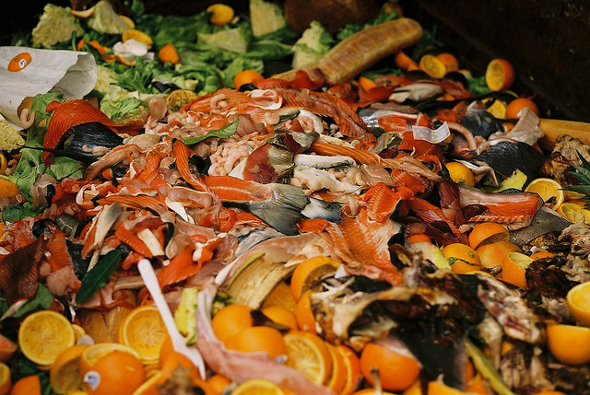


School Food Waste Assembly
How Can You Help Stop Food Waste?
Notes:
Mitchell Center Slide: Good Morning, ___________________(School name)
Introduce yourself
Working to end food waste – bad problem
Thanks to your ND, cafeteria staff and your principal & teachers – your school has been selected for this special program to reduce food waste!
Give overview – Today we will learn about food waste problem and then have some games and activities to learn what you can do to reduce food waste right here in your school cafeteria…and at the end, I’ll have some questions and sticker prizes to see who paid attention!!
If you have any questions for me – just raise your hand (OPTIONAL DEPENDING ON TIME) Let’s Get Started!!

Slide 2
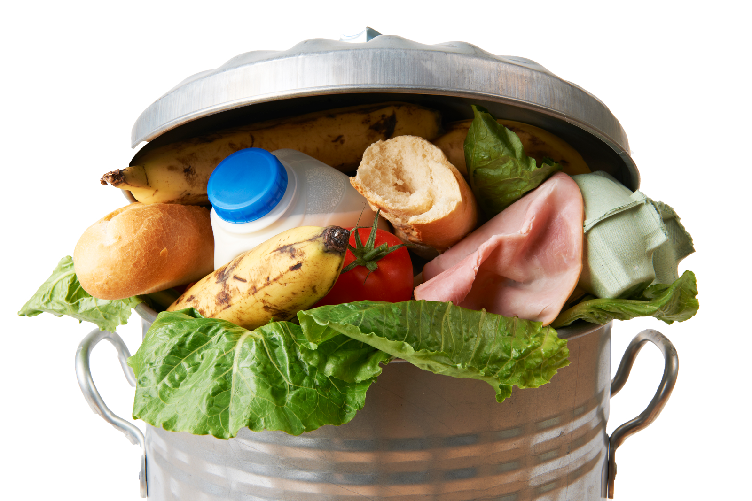
What is Food Waste?
What is Food?
Why is Food Important?
Who needs Food?
What is Food WASTE?
Notes:
Begin with a discussion of food. This can include favorites (meal, dessert, fruit, etc.), favorite cafeteria food, what kids enjoy on their birthday or certain holidays, what they like to eat when they don’t feel well, what they can cook/fix themselves, etc. The emphasis is on the goodness of food!

Slide 3
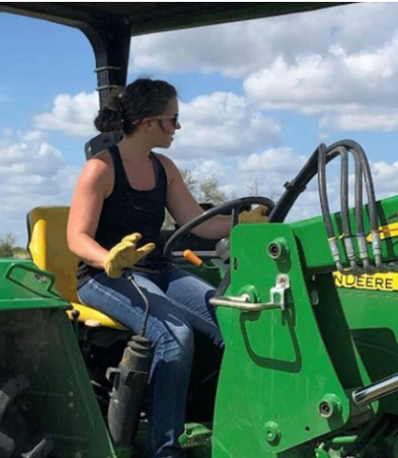

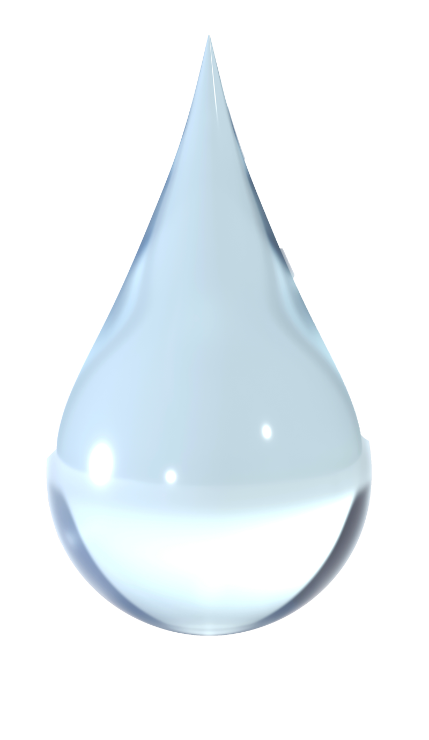
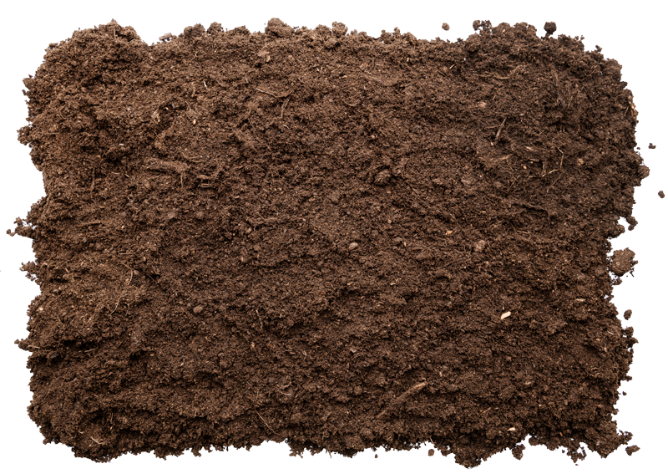
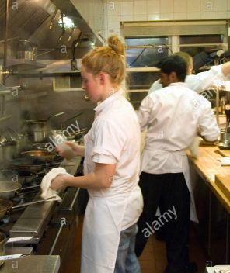
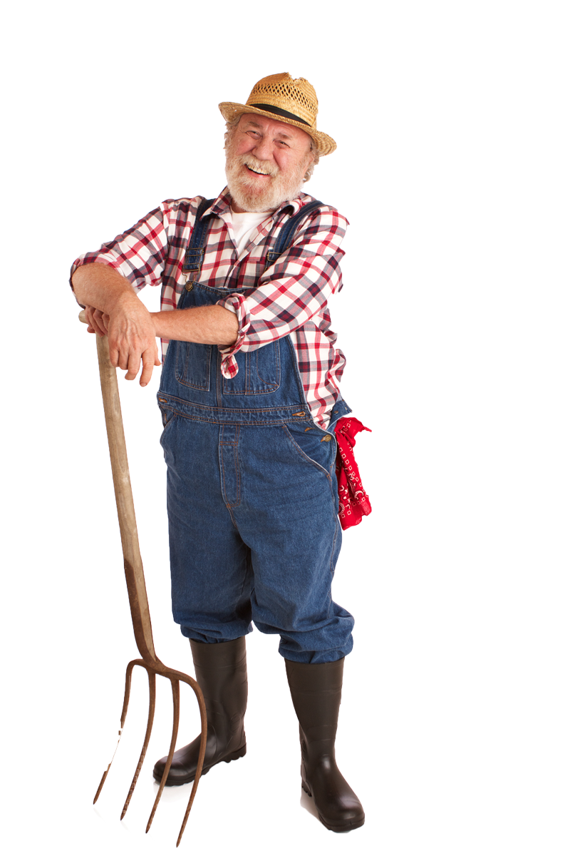
Food: How does it get to your plate?
Sunlight
Water
Soil/land
Hard Work!
Lots of natural resources and hard work!
Notes:
But how does FOOD get to our plates? Does it magically appear? Does it come out of a “food machine”?
What do you think it takes to make food? (Reveal each bullet as you name it.)
Growing food needs sunlight and water. It also need land. Plants draw nutrients from the soil, and animals need land to live on. In the United States, we use a LOT of our water and land to make food —80 percent of our water and 50 percent of our livable land!
And all food, whether it’s a vegetable, a fruit, or an animal, takes hard work! People plant seeds, pick fruit, care for animals, and do many other jobs to make sure we have food on our plates.

Slide 4
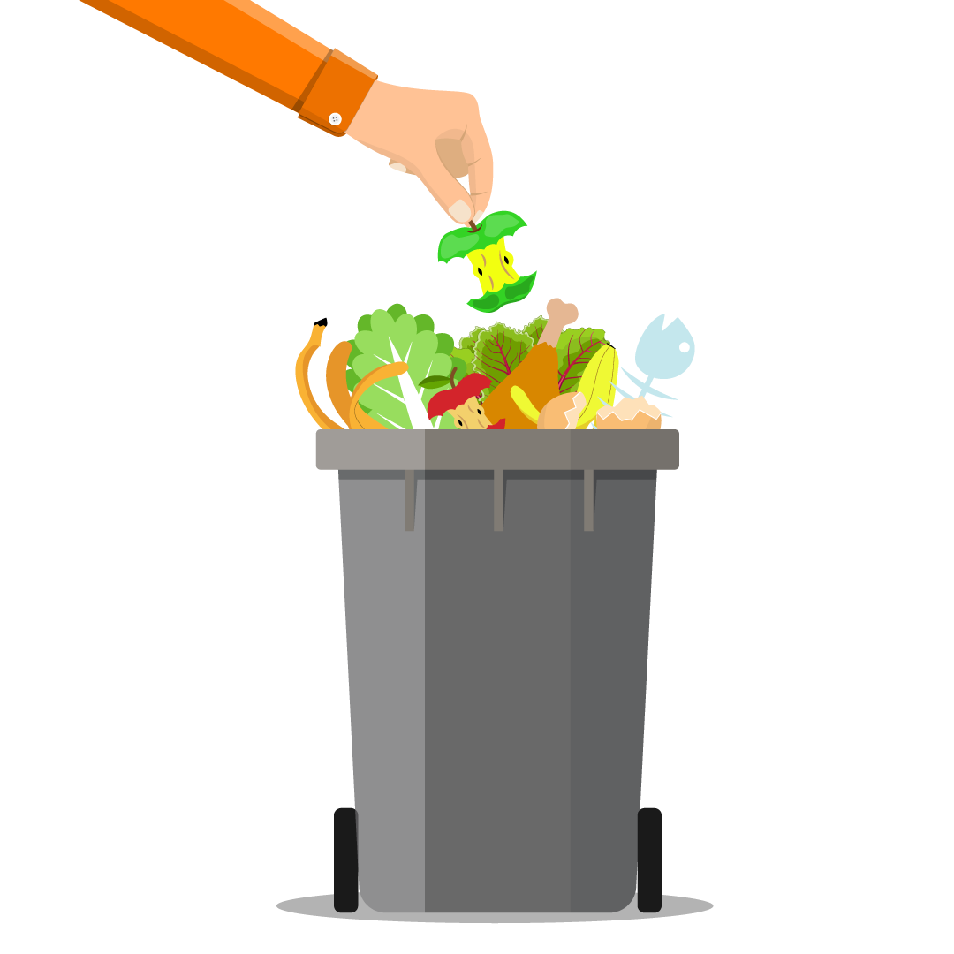
Food waste costs money and uses valuable resources.
We throw away
30–40%
of our food!
Notes:
How do we treat things that we love and take a lot of work to make? (Give some examples— electronics, cars, money etc.) We are careful with them, take care of them – would you throw them in the trash? So what about food? It costs money, it’s hard to make, and we need it to live. Do we ever put food in the trash? Should we throw food away? Actually, people waste 30-40% of all the food we make!!

Slide 5
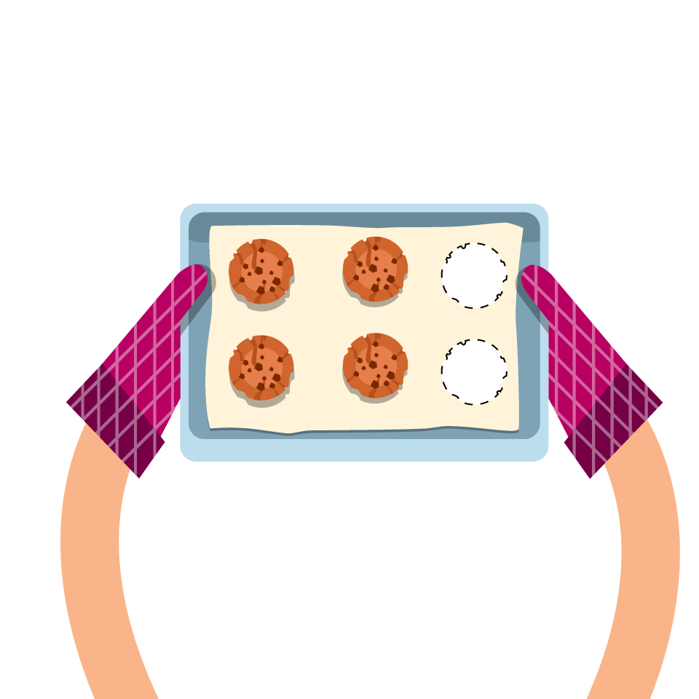
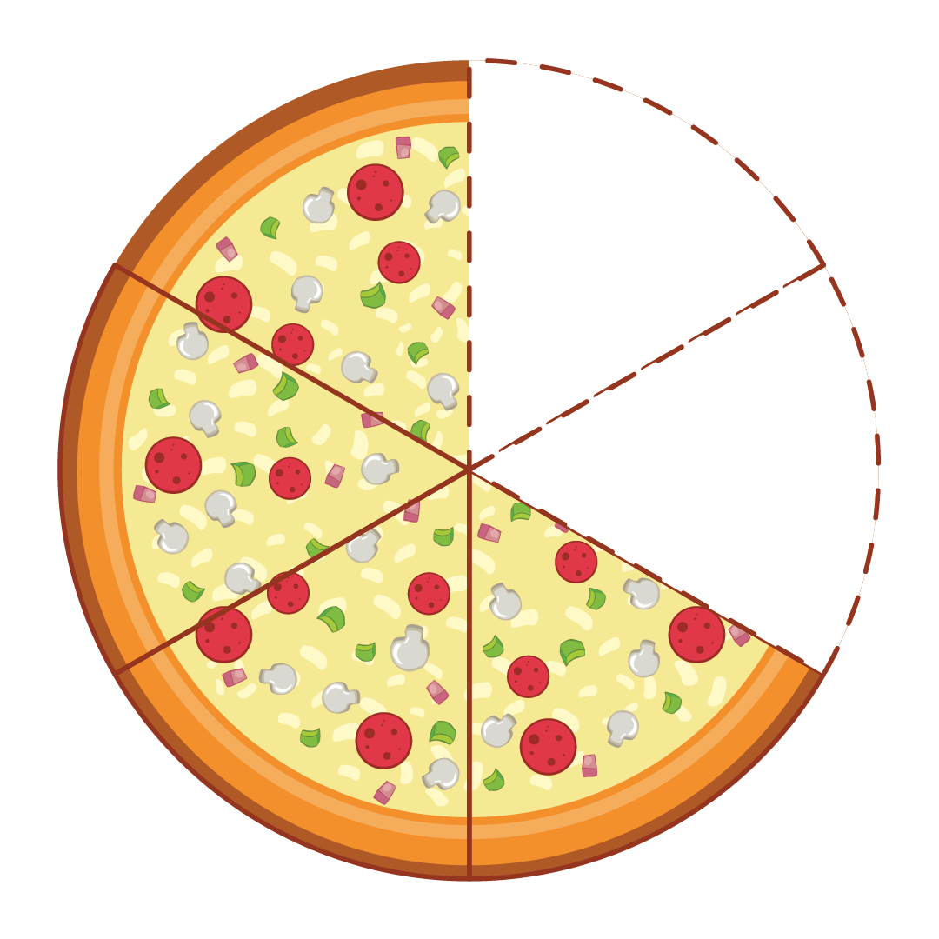
What does 30-40% look like?
Notes:
30-40% is a lot but it’s hard to know what that means without seeing it. This slide shows what it looks like.
When we throw away our food, we are also wasting everything that went into making that food --all that hard work, water, energy and land wasted! Also, do you think that those two pieces of pizza or cookies – could be eaten by someone?
So, why do we throw away so much food?
Do you think it’s a problem to throw so much food away?

Slide 6
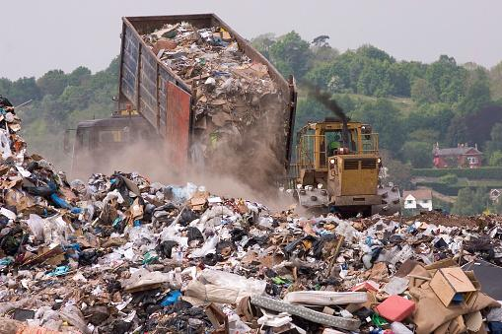
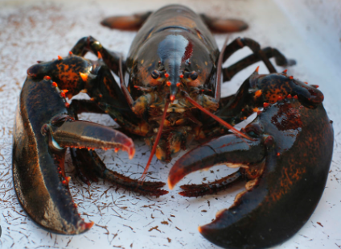
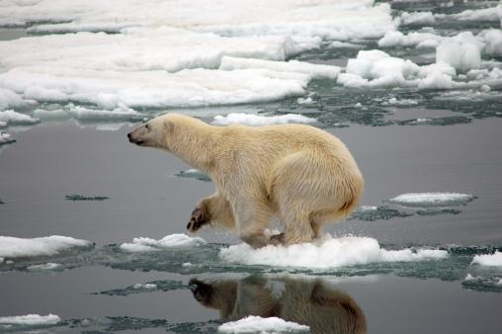
What happens when food goes in the trash?
Grows
Landfills
Warms
Climate
Notes:
Let’s look at what happens when we throw all that food away…
Where do you think our trash ends up after we throw it away? Most of the food we throw away ends up in huge piles of trash called landfills.
Even worse, food is not supposed to be in trash landfills; the food rots and makes something called methane, which is a greenhouse gas. Greenhouse gases trap heat in our atmosphere, and methane traps a LOT of heat. This makes food waste a leading cause of global warming, which causes many problems for wildlife…
vanishing ice for Arctic animals, warming oceans stress and eventually destroy coral reefs. Here in Maine, our Gulf of Maine is one of the fastest warming ocean regions on the planet. All our marine life is being threatened including our lobsters who cannot survive in warmer water.

Slide 7
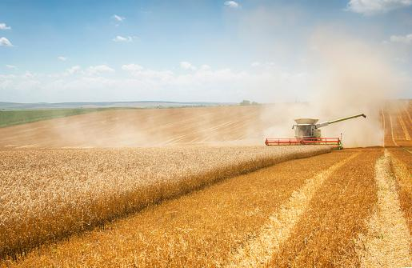
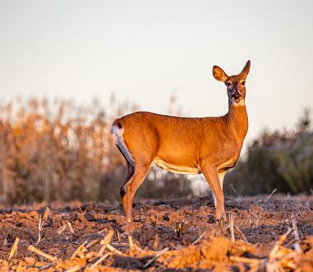
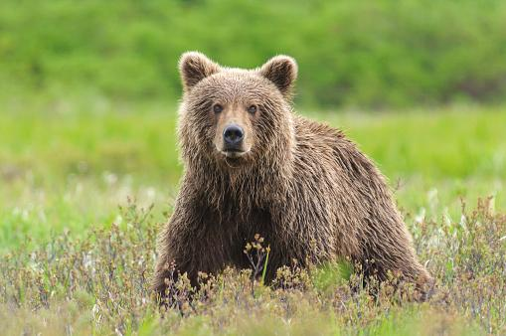
Food waste hurts wildlife.
When we waste food, farmers need to grow more food for people.
This means they need to use more water & land.
Then, animals don’t
have as much land
to live on or natural
food to eat.
Wastes the land and food that animals need.
Notes:
Ask the children to name their favorite wild animal. Talk about where that animal lives and how much land and food they need to live happily. Does anyone like sea life – dolphins and seals - as people waste food from oceans, we need to fish more and sea life has less to eat.

Slide 8
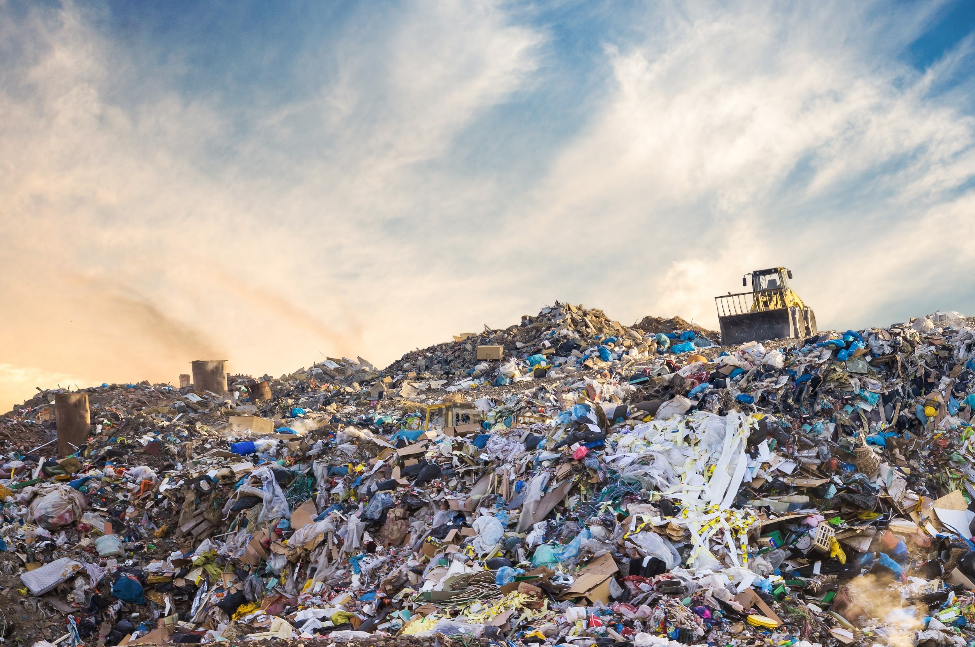
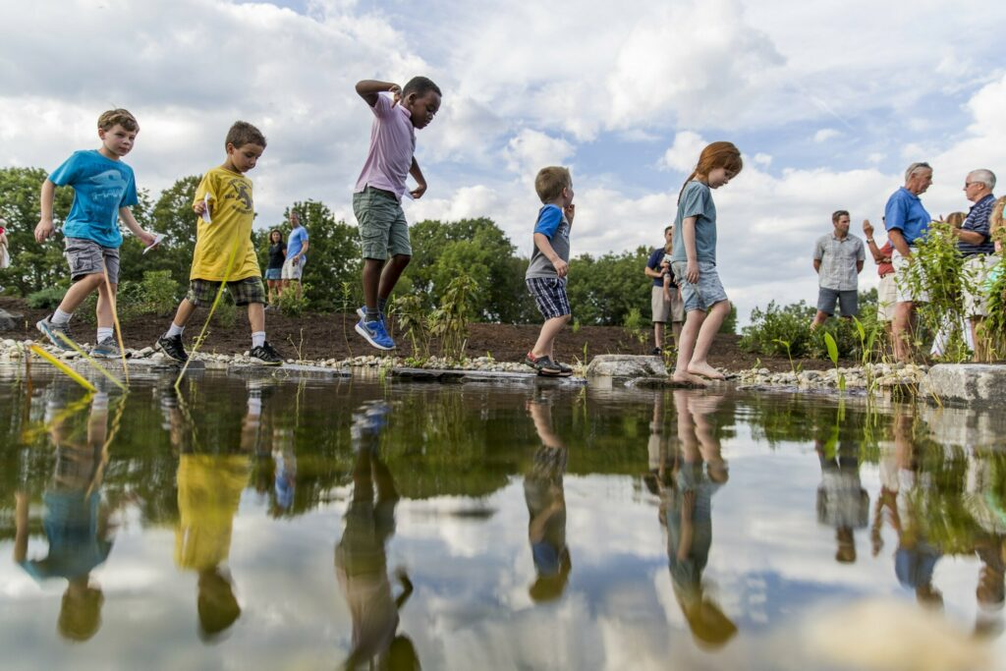
Food waste hurts us.
When we waste food, it goes into a landfill.
Rotting food in landfills creates a gas called
methane.
This gas pollutes the air and heats up the planet
making it a leading cause of man-made climate change.
Rotting food in landfill also creates a nasty liquid called leachate which can pollute our water.
Harms the environment where we live and play
Notes:
Ask the students what they like to do outside? Now talk about the air we breathe and why we need to protect it.
Ask if anyone likes to go swim and play in ponds, lakes, and rivers – give examples. Now talk about how food waste in landfills make a nasty liquid that can leak out of the landfill and into nearby water like ponds, streams and even our drinking wells!

Slide 9

YOU can stop food waste
Why do you waste food
How can you waste less
Notes:
Changing what we do starts with figuring out the whys.
Start a short conversation about why we waste food. Some ideas could include they don’t like it, they were too full (snacking?), they didn’t have enough time to eat it, the food was cold/undercooked/burned, etc.
Now talk about what students could do differently to avoid this waste. Examples: We can tell our parents and cafeteria worker if we don’t like something, we can only take what we can eat, and we can snack less. (Optional: Studies also show that a longer lunch period and having lunch after recess helps kids eat more of their food!)

Slide 10
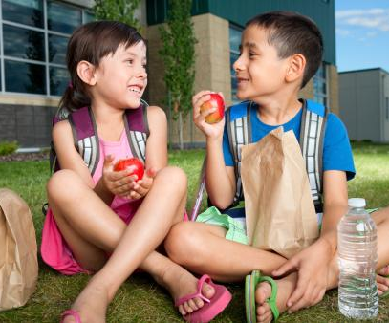
1. Eat Food
Feed your body.
Save to eat later.
Use Share Basket.
Notes:
Most important is to eat our food – it has important nutrients and energy that we must have to think, work, and play! Take what you will eat and eat what you take. Make sure to feed your body.
Or you can put food away to enjoy later. What are some foods that are good to save? Are you ever happy to have some food or leftovers that you saved? How about old bananas to use smoothies or banana bread? Enjoying food later is a great way to fight food waste!
Finally, your cafeteria has a Share Basket – who knows what that is? How does that help you stop food waste (prompt that you can put food in, but it also is there for people to take food out to eat!)

Slide 11
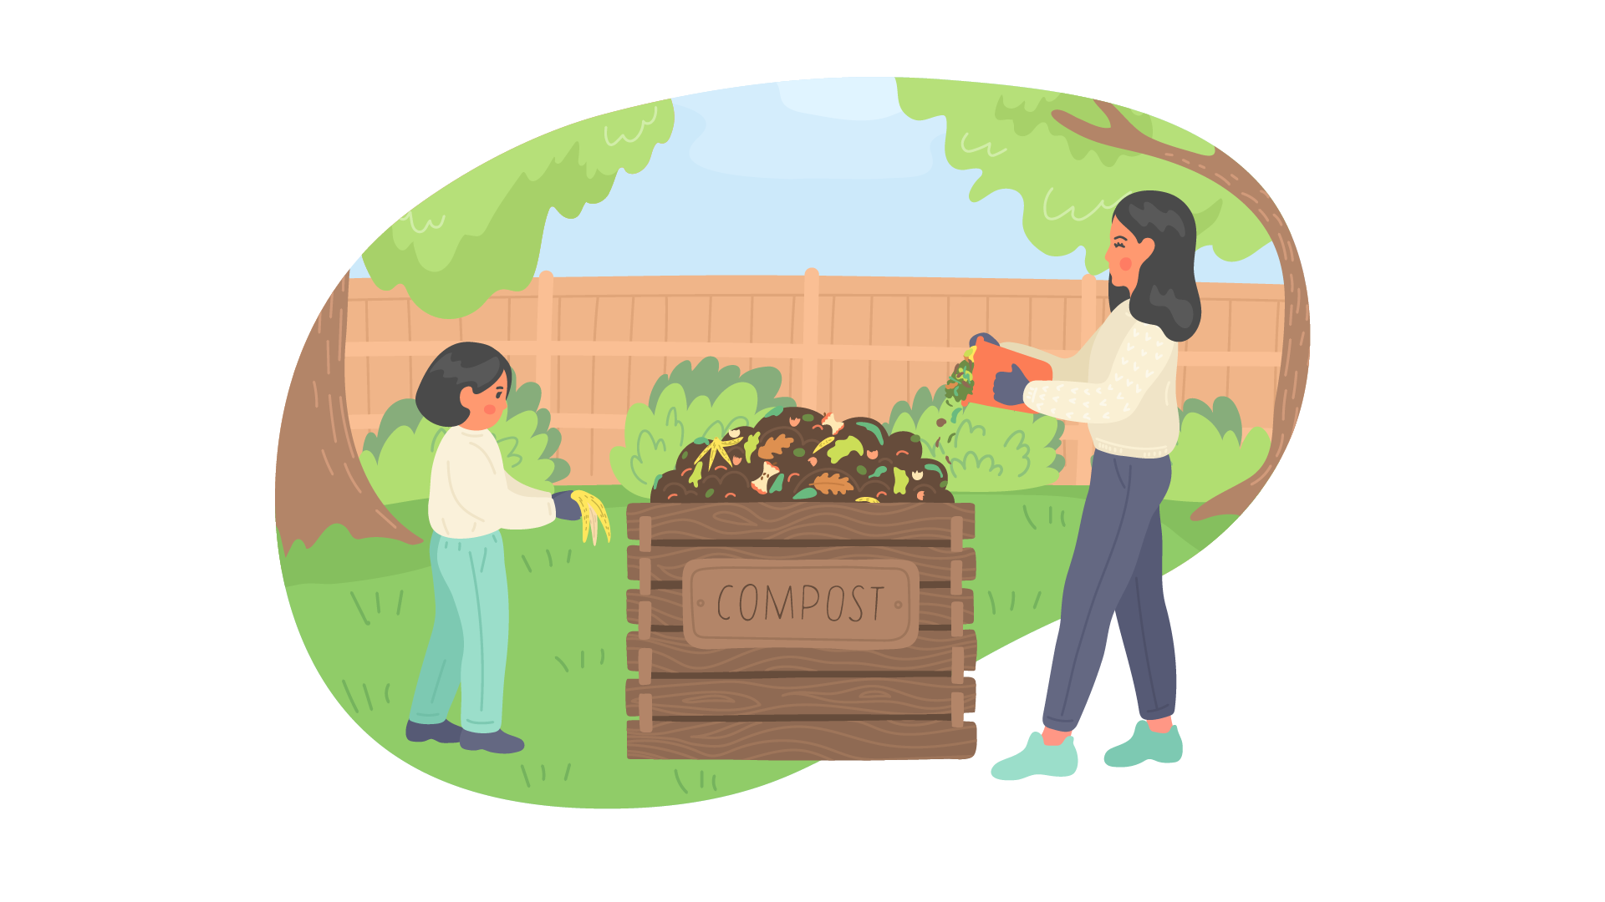
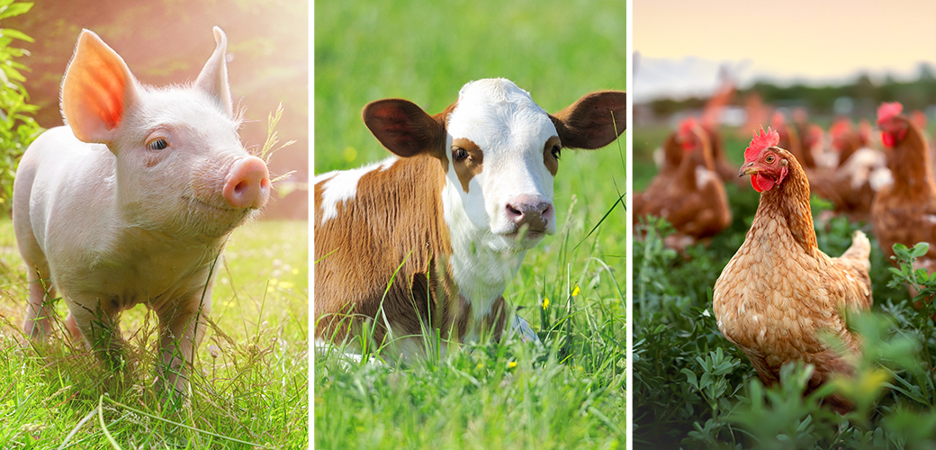
2. Rescue Food
Collect to feed farm animals
Collect to
feed gardens
“Maine Food – Too Good to Waste”
Notes:
Sometimes food is not good for people to eat – what are some examples? Should this food be thrown into the trash?? NO!
Even if people can’t eat the food or the food scraps, food still has important vitamins and energy to feed animals – and even our soil.
Do you know what composting is? Instead of throwing your food in the trash and in the landfill, it can be collected to go in a special pile called “compost.” As the food in a compost pile breaks down, it becomes excellent fertilizer for gardens. Food waste also gives off a lot less greenhouse gas as compost than it would in a landfill. The following things are great to compost: fruits and vegetables, eggshells, nutshells, tea bags, and coffee grounds.
Do you know anyone who rescues their food waste for animals or compost?

Slide 12
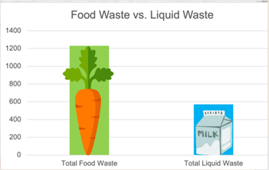

Take the Challenge:
Measure Your Food Waste!
Weekly Progress Chart
Notes:
Did you know that just measuring how much food you waste actually helps us waste less? Sometimes just looking and thinking about the food we waste can help us to change our behavior. (Describe how you’re your class or school will be implementing the food waste audit to help reduce your food waste.)

Slide 13

Let’s Get Started
How can YOU stop
cafeteria food waste?
Notes:
Here’s the second part of the presentation – given what you learned about food waste…what can you do in the cafeteria to stop food waste?

Slide 14
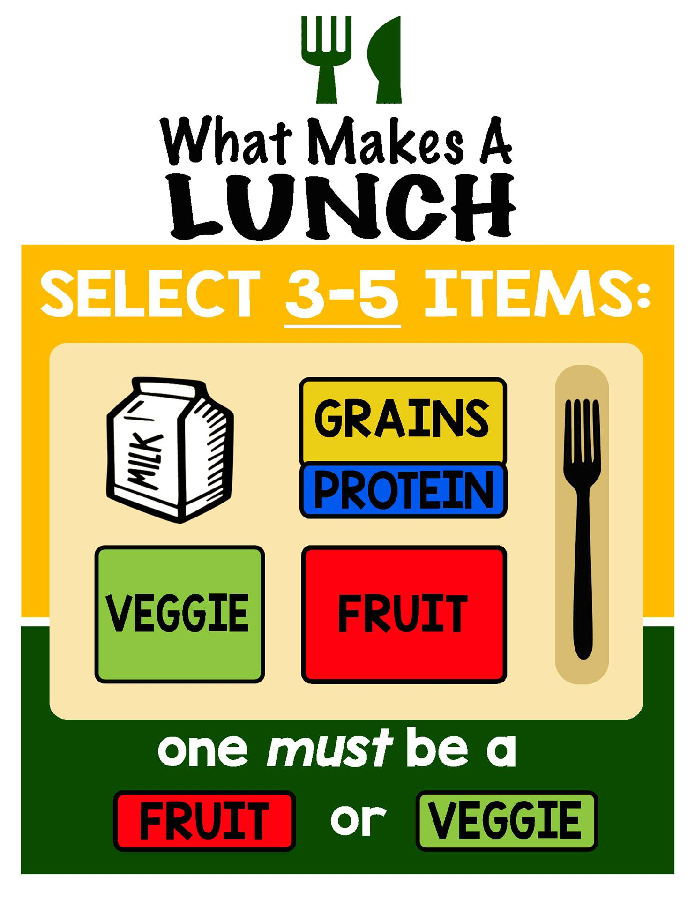
Eat Your Meal
Notes:
First, Eat Your Meal – but what is a Meal? Who knows??
Answer: Any 3 items, but one item must be fruit or veggie – quiz them using a variety of cafeteria lunch items and a cafeteria tray – especially show that milk is just one item you can choose BUT milk is not required to have a meal – it’s just an option.

Slide 15
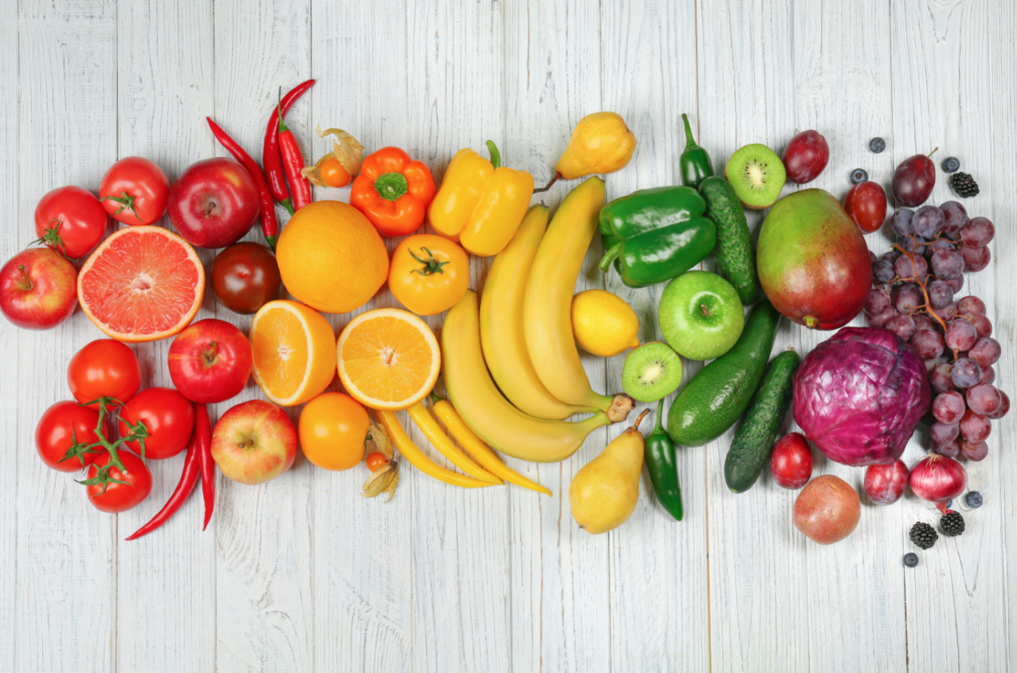
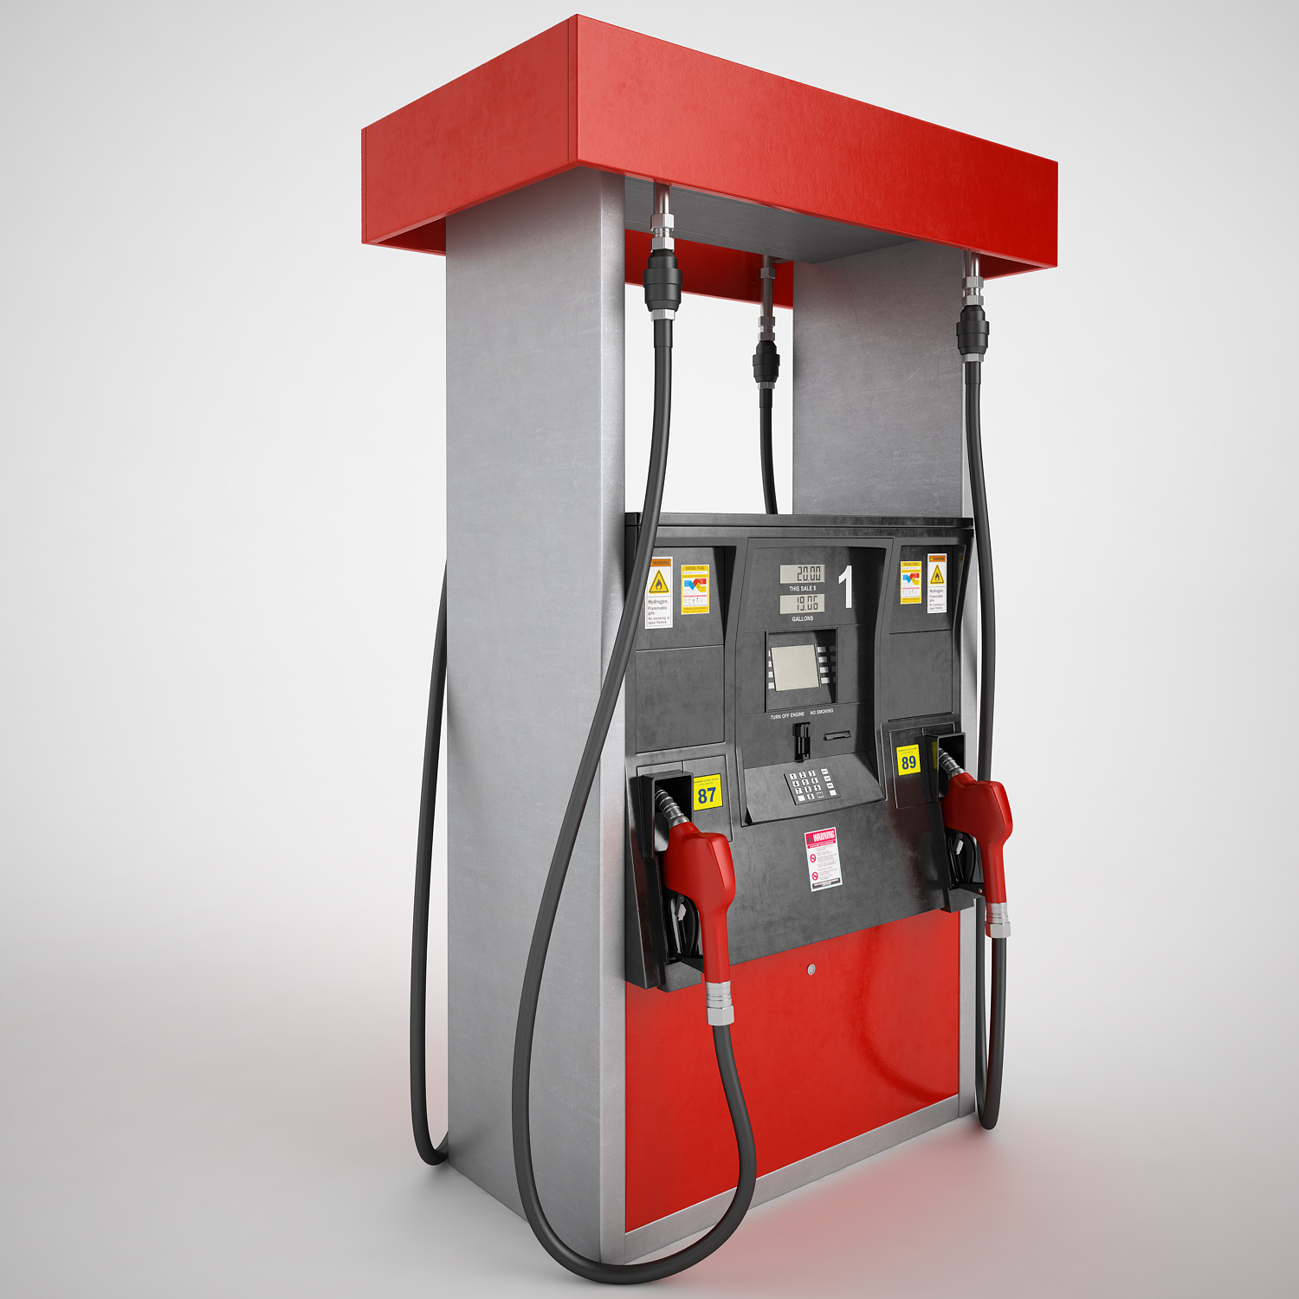

Always fruit & veggies
CARS
The fastest, most furious sports cars ever
From old-school roadsters to junior supercars, this is our roundup ...
By Alex Goy
27 January 2020
Notes:
Why do I have to take a fruit or veggie? Who has driven in a car, What does a car need to go, Cqn you feed your car just anything…that’s like your body…you need to feed it high power fuel…THAT”S THE FRUITS & VEGGIES

Slide 16
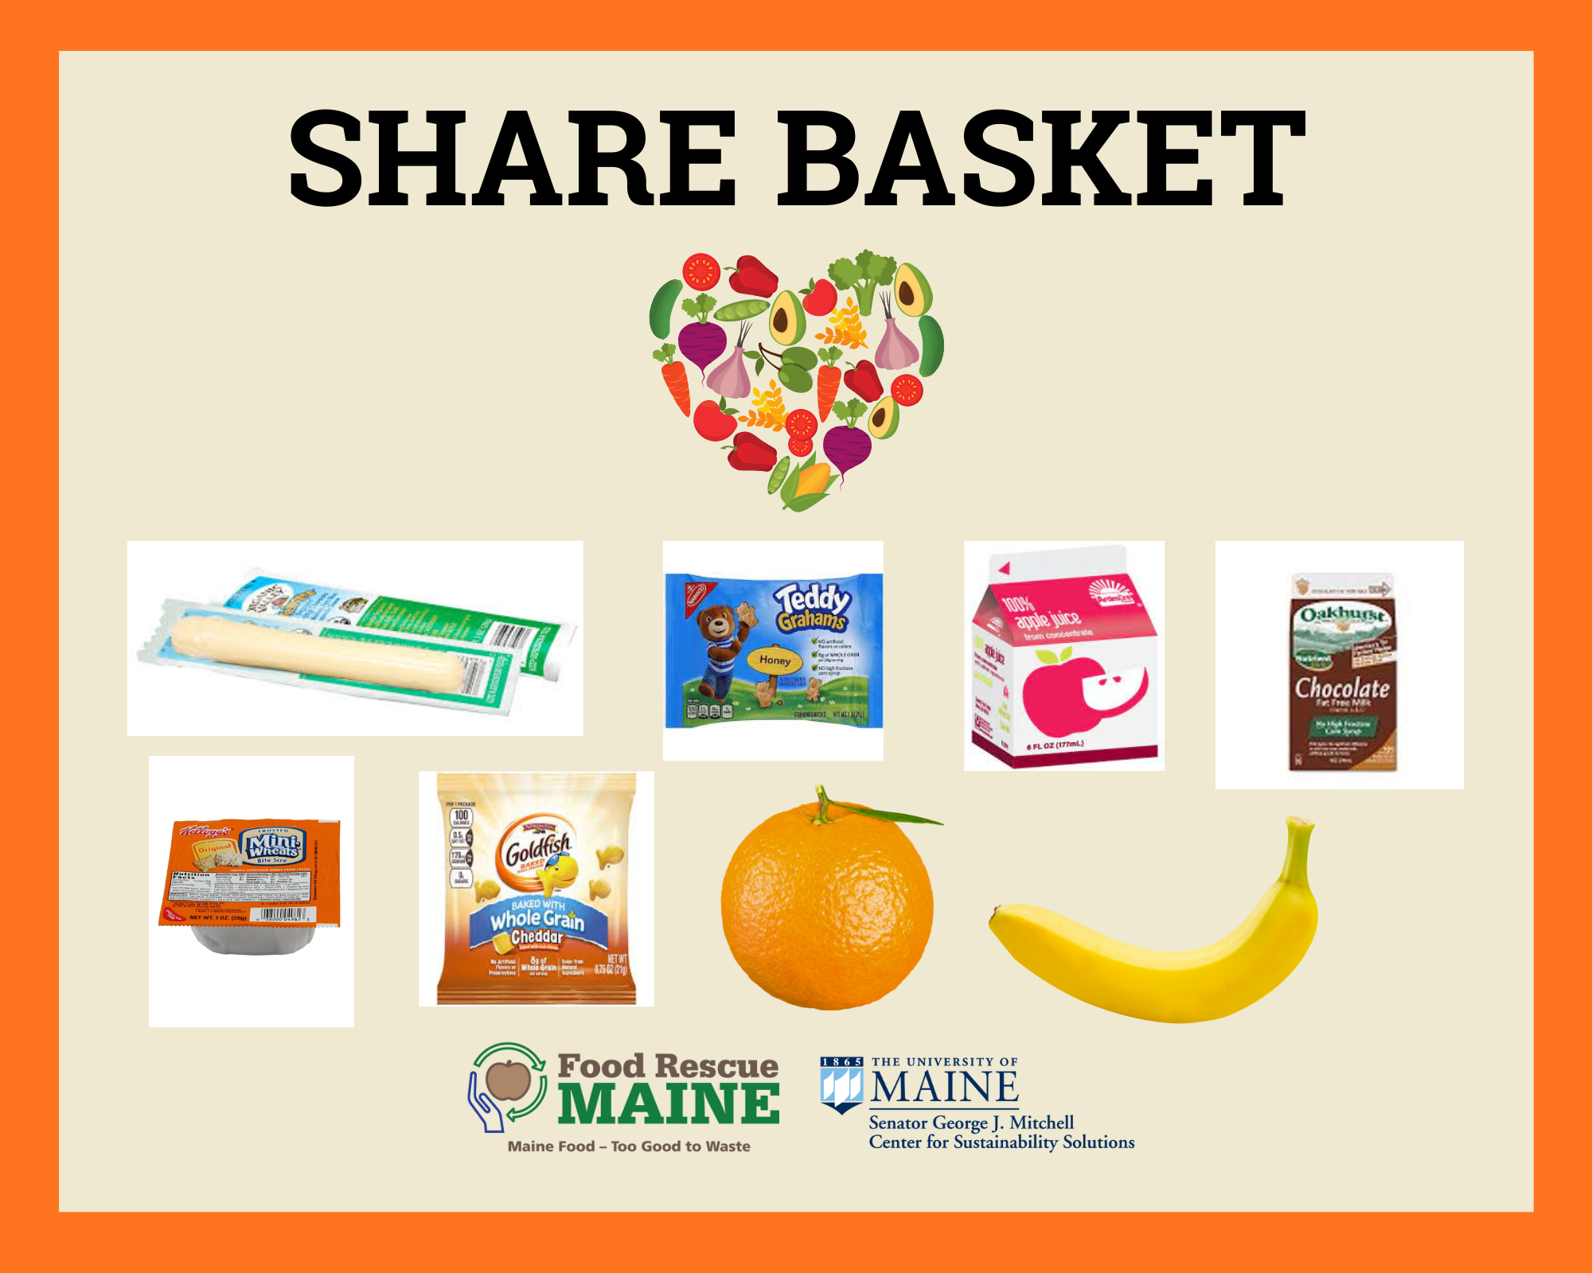
Use the Share Basket
Notes:
Who has seen this – SHARE BASKET sign? Why is this important to use to stop food waste? (Remind that you can put in – and take out!)

Slide 17
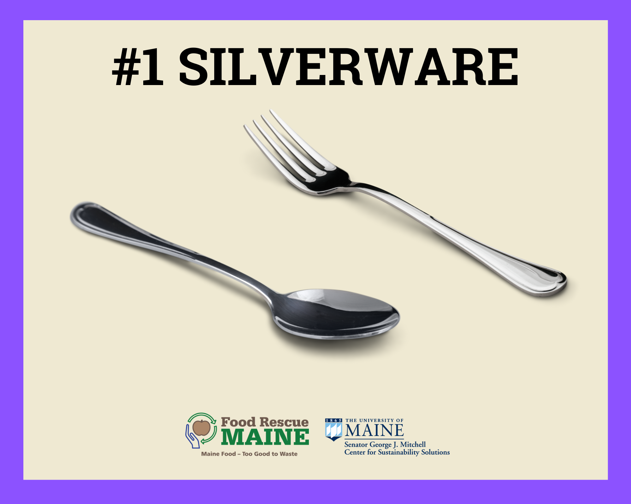
Use New Sorting Station
Notes:
What is the reason for the sorting station? What are the stops? The best way to go to sorting station is to take what you’ll eat and eat what you take!! Uses the fewest stops, #1, #3, #5

Slide 18

Notes:
Otherwise, what goes here #2? What can you do to skip this stop?

Slide 19
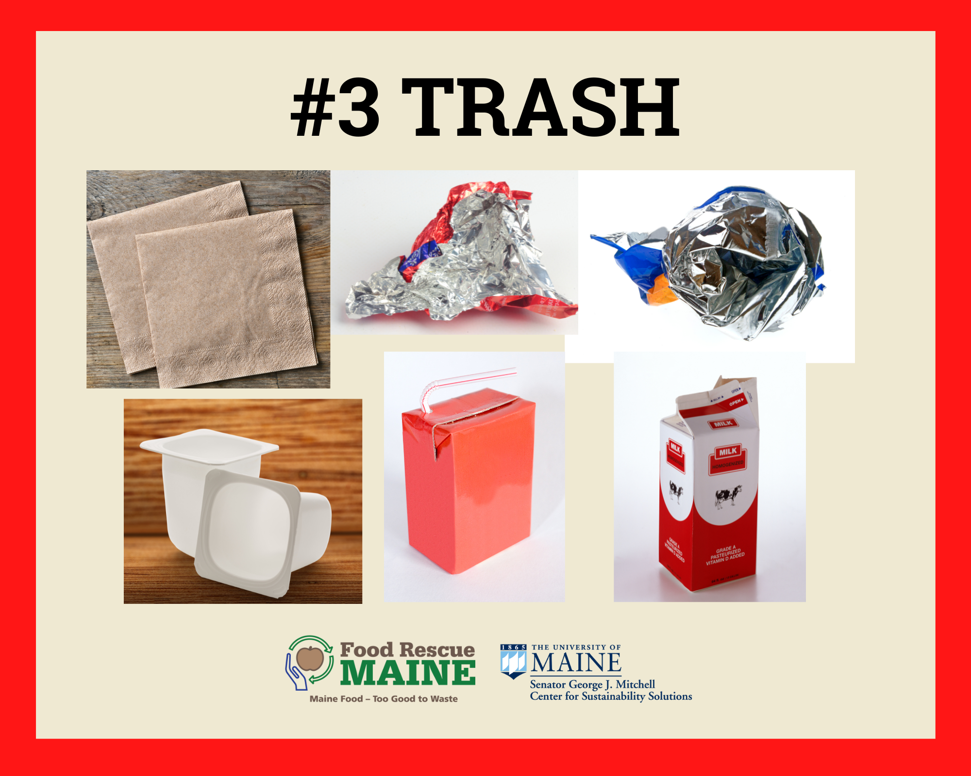
Notes:
Be sure to separate trash from food – what is trash?

Slide 20
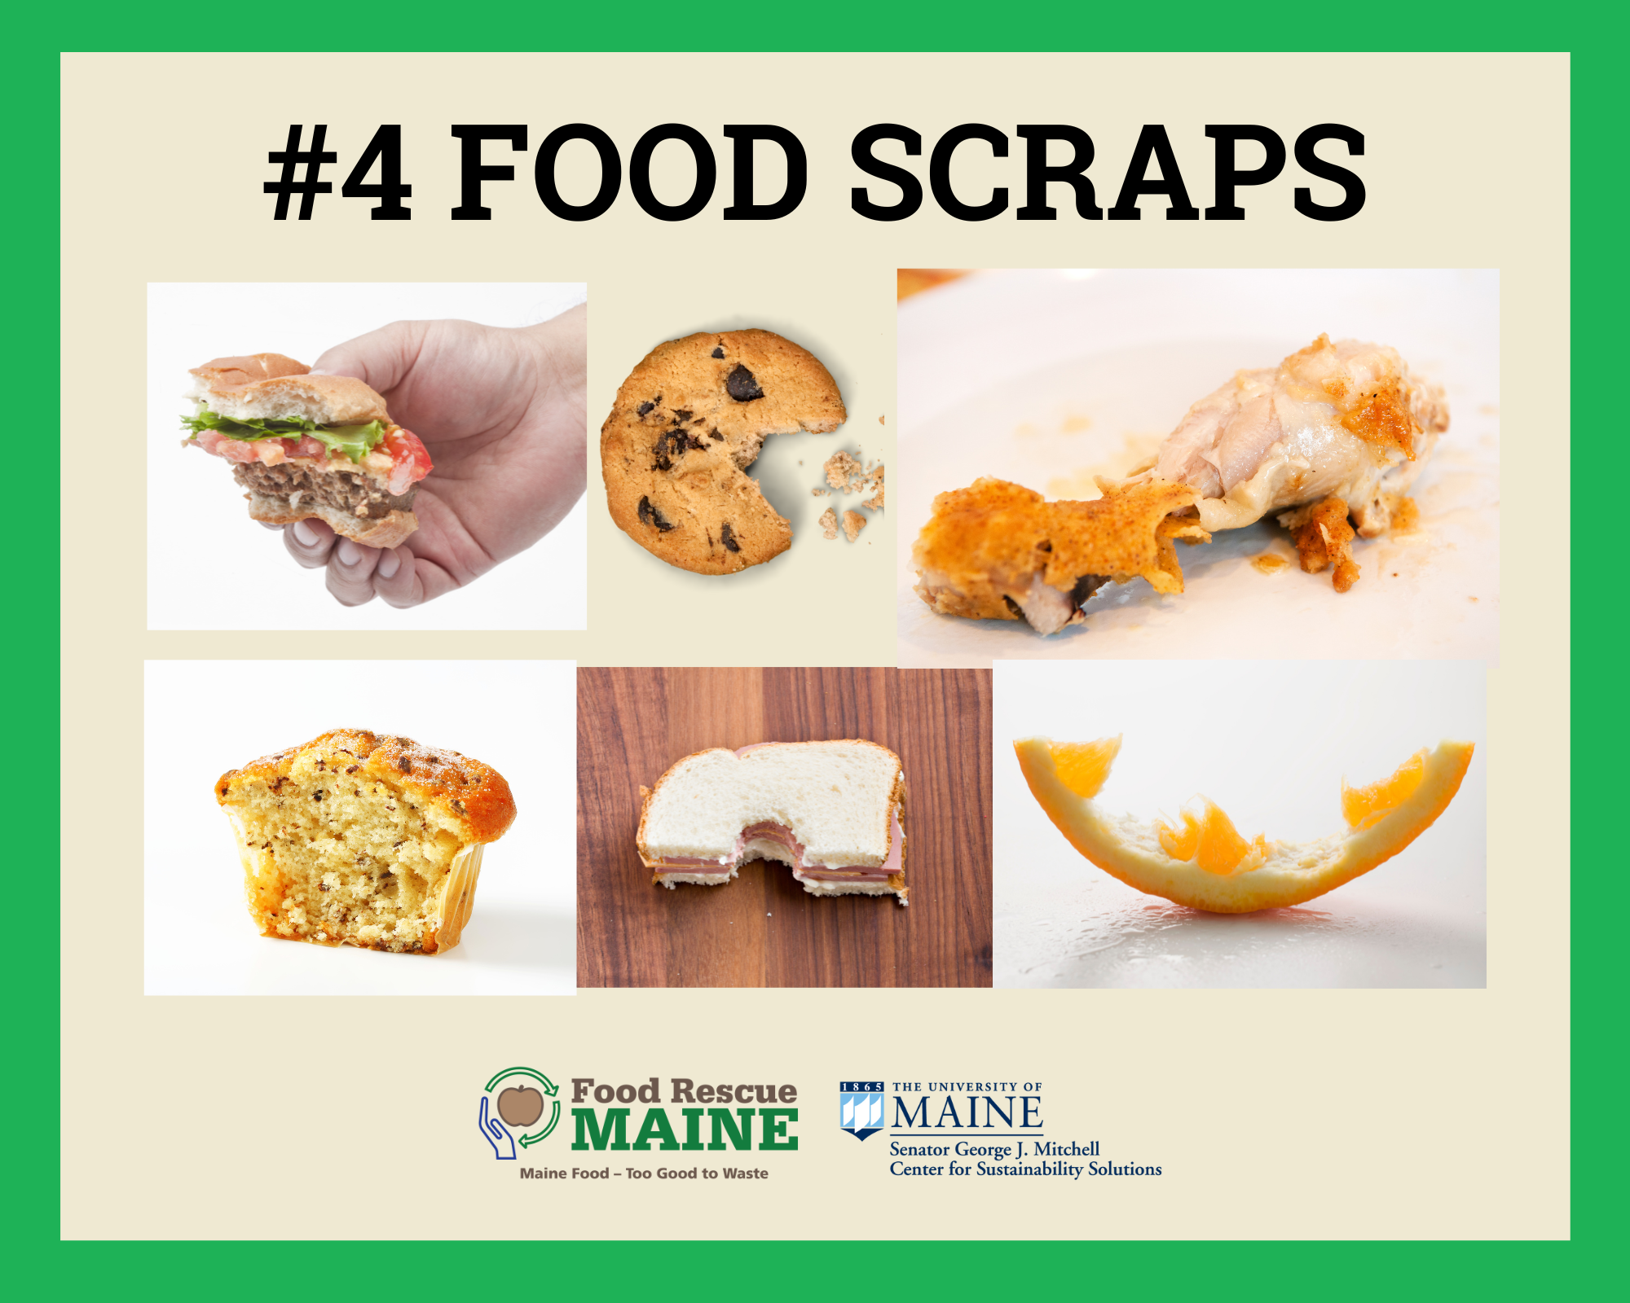
Notes:
Only food goes here because you can not feed animals or soil with trash!! So what is food? What is trash? What about bag of potato chips? What about container of fruit? What about package of crackers? (Remind that food and packaging need to be separated to go to two different places!

Slide 21
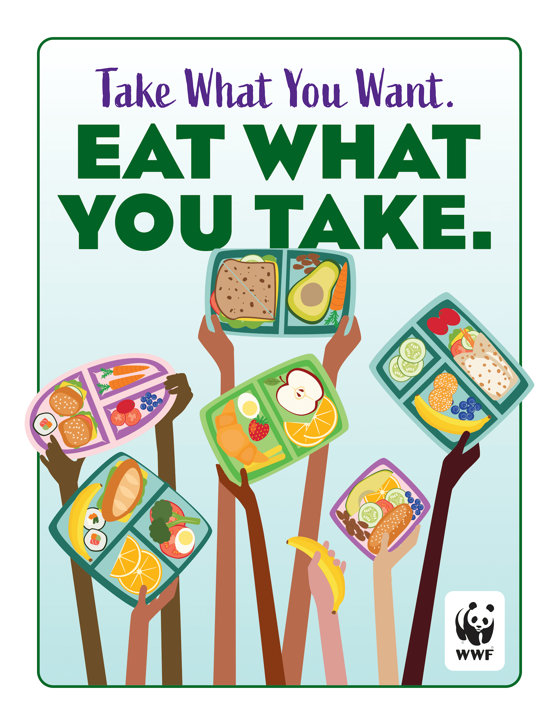
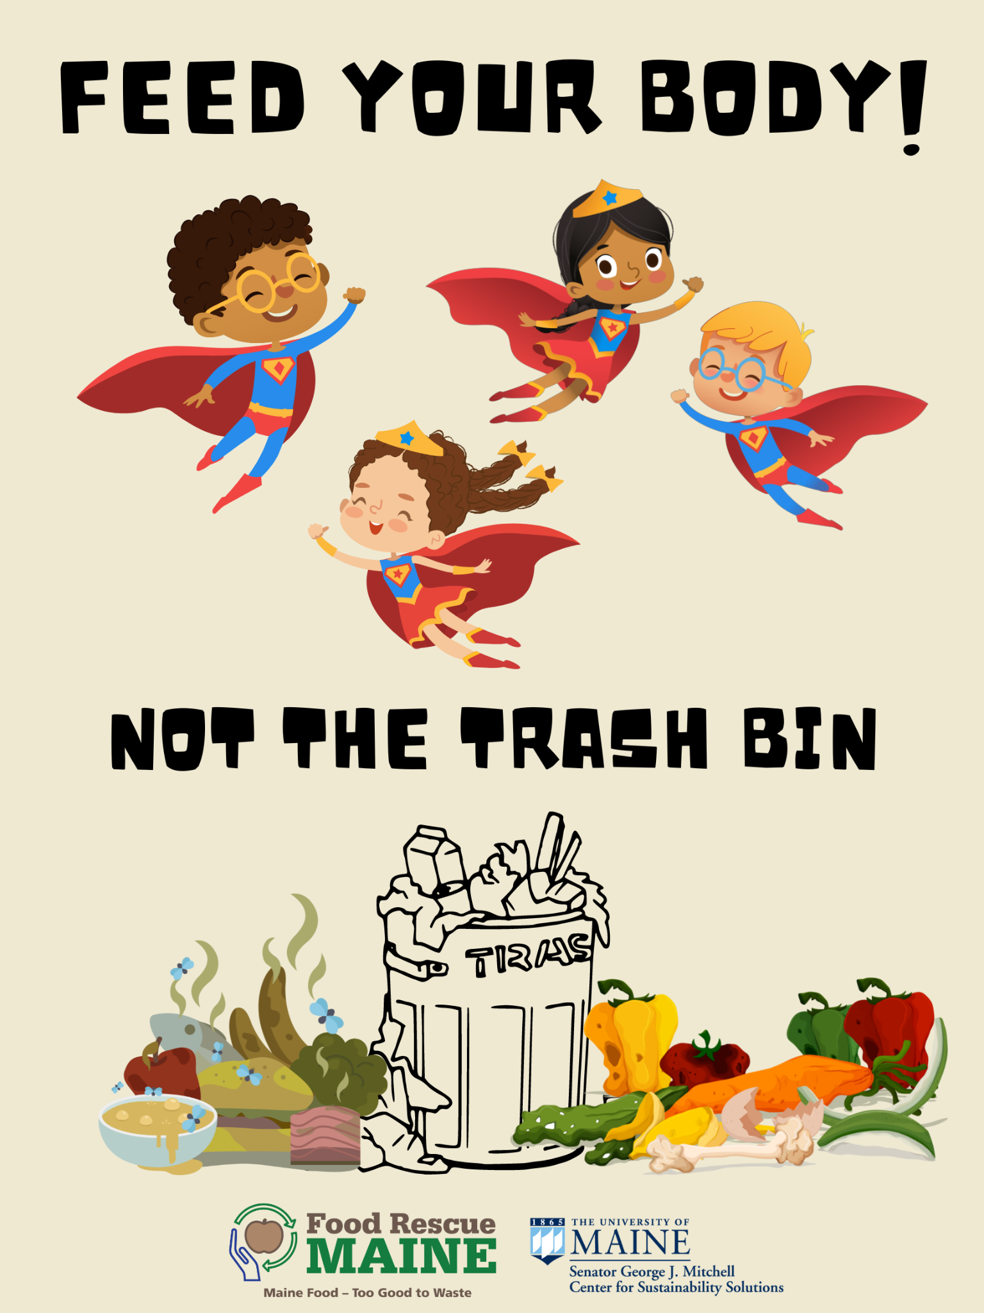
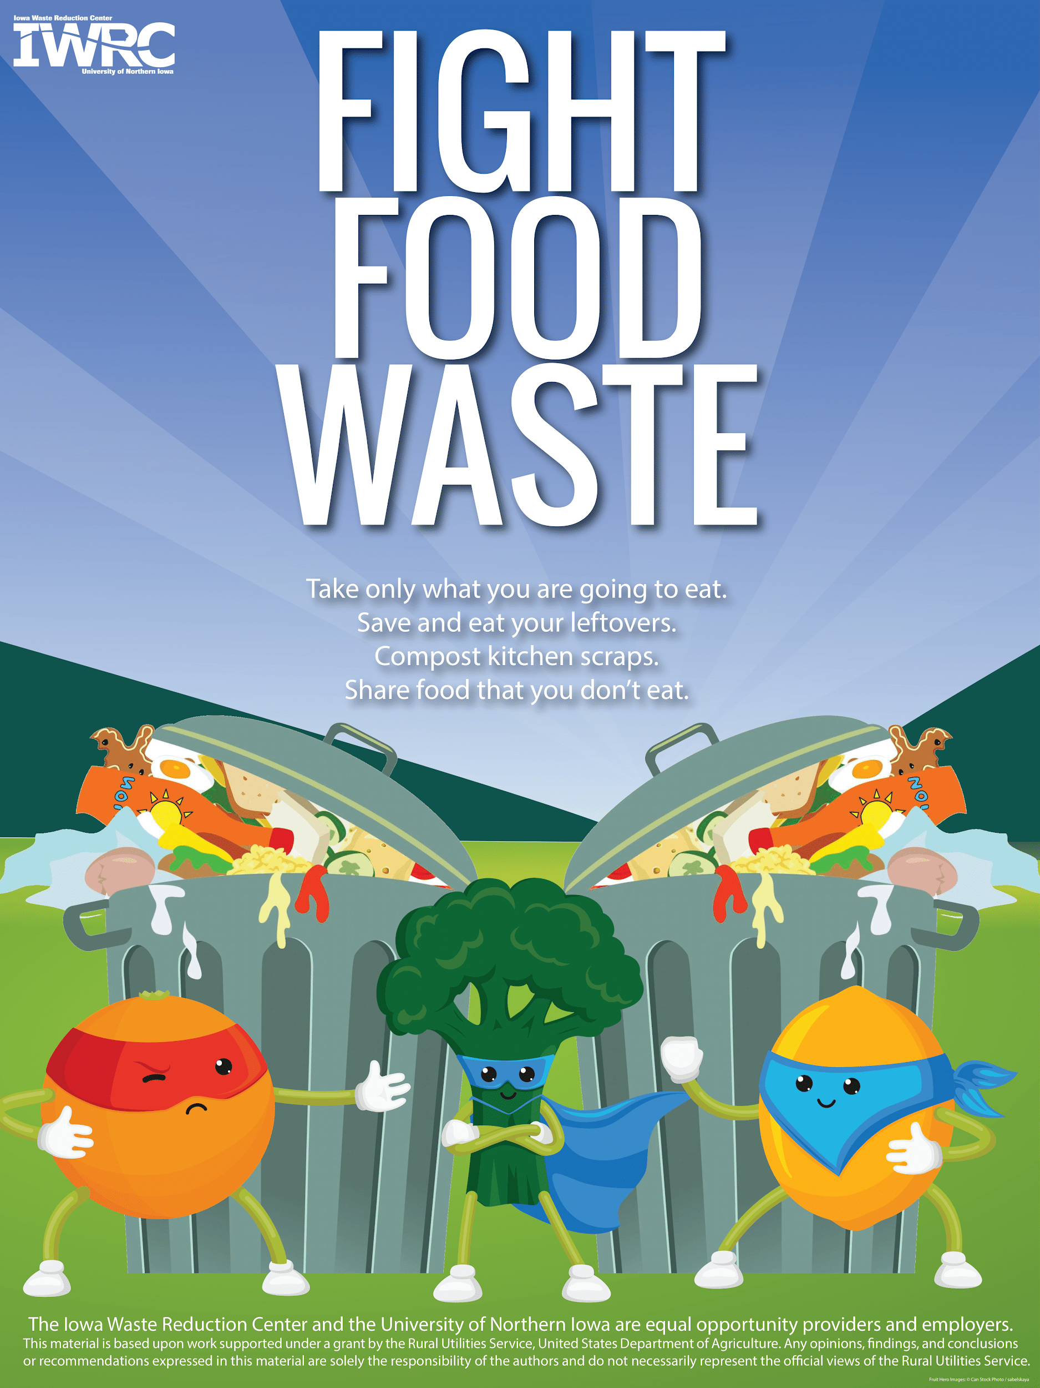
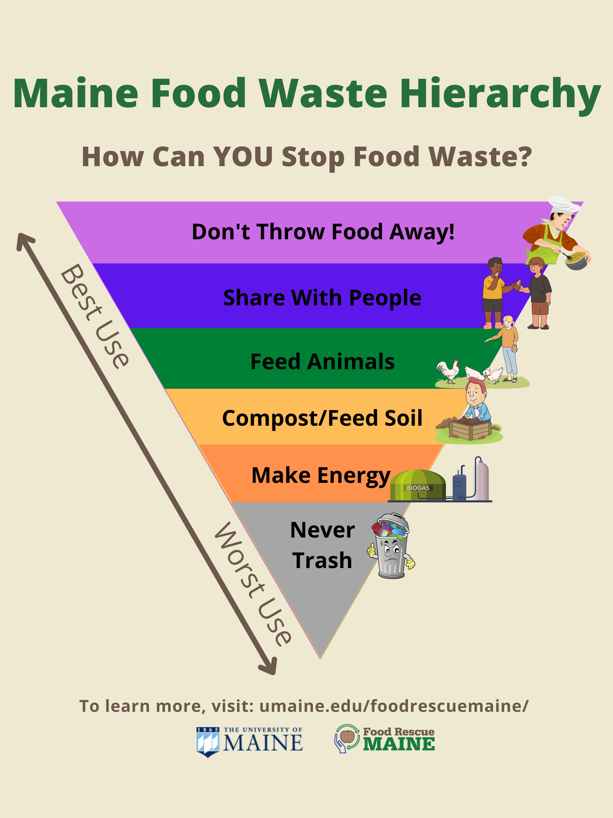
NEW! Cafeteria Food Waste Posters
Notes:
To help remind you about what you can do to stop food waste – New Cafeteria Posters!

Slide 22
Be a Maine Food Waste Hero!
STICKER TIME!!
What did you learn?
What will you do?
Notes:
And, now let’s see who is ready to be a “Maine Food Waste Hero” like the ones here…
Share what they learned and give stickers as reward!
For example: What is food waste? (Food in trash) Why is it bad? (landfills, hurts people, etc) What one new thing you will do?

