Slide 1

Building Maine's Farm Food Infrastructure A Social Benefit “Upcycled Food” Brand
A Triple Bottom Line Solution For Wasted Food and Food Loss

Slide 2
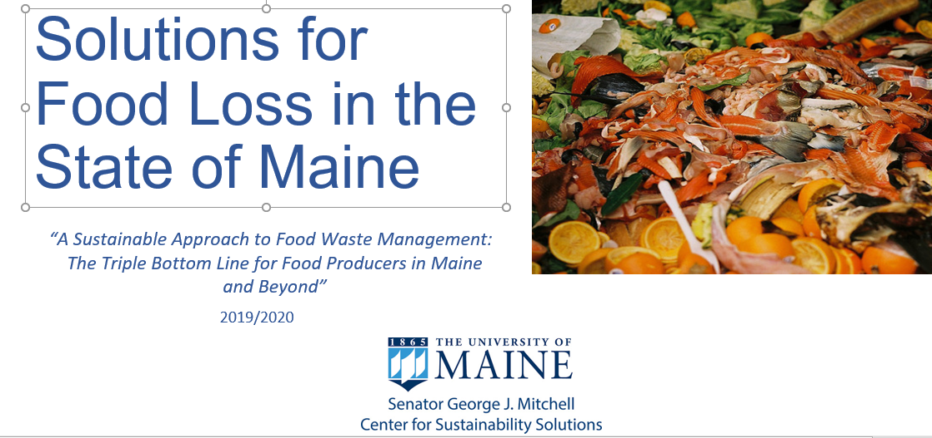
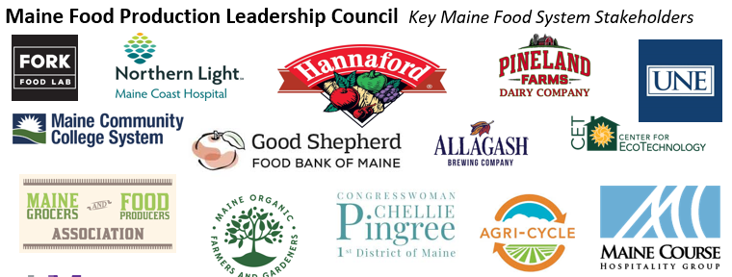
Introduction
Background
Launched Mitchell Center Project to Identify Maine Food Waste
Solutions - 9/2019
Held Stakeholder Working Sessions - 11/2019
Reviewed Global “Best Practice” Food Waste Research
Identified Six (6) Circular Food Waste/Food System
Solutions – 5/2020
Notes:
Special = Created for Maine towns, Supported by UMaine/Mitchell Center research/education, Uses current DEP grant funding opportunity, Limited participation

Slide 3
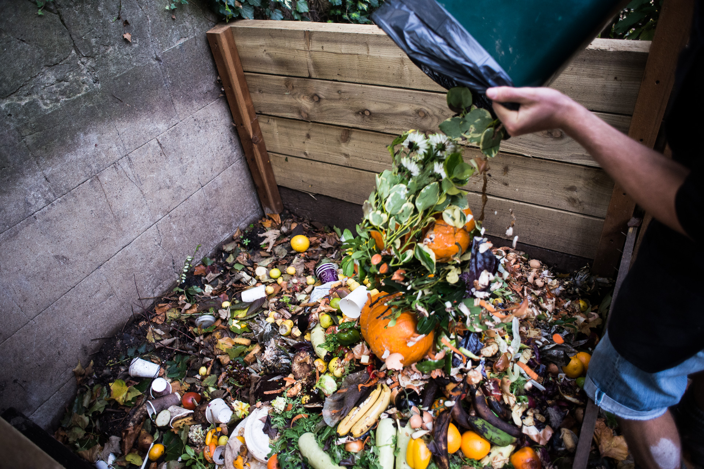
B
Key Research Findings
About 40% of Food Produced Is Never Eaten.
Maine leads New England in food insecurity and 12th in U.S.
Food Waste in Landfill Causes Climate and Water Problems.
Nearly 30% of Maine’s Solid Waste Stream is Food Waste.
Wasting food also wastes water, energy, soil, labor used to produce the food.
(Data from ReFED, www.pingree.house.gov/foodwaste)

Slide 4
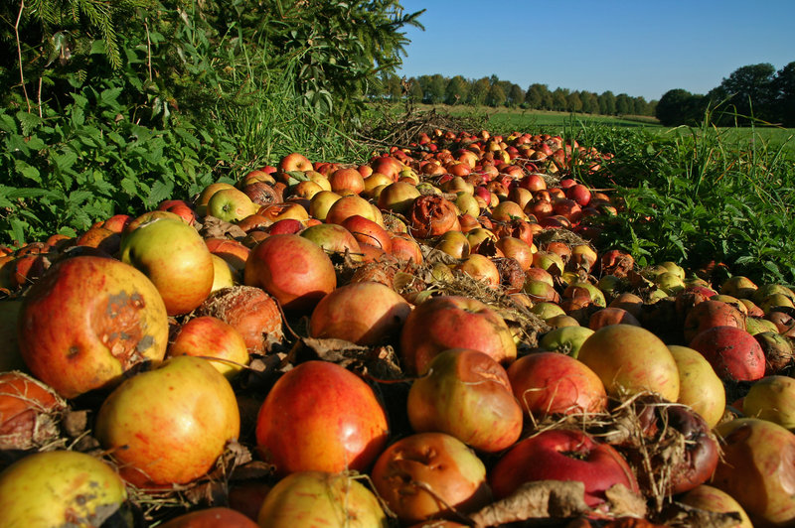
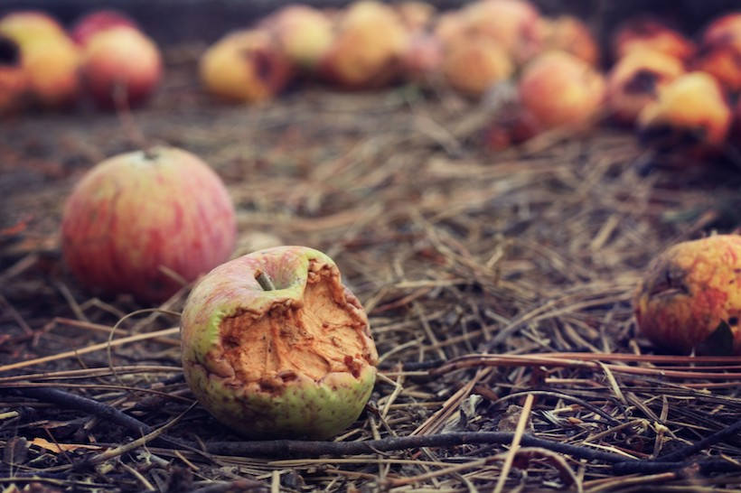
Solution 4: Build Maine’s Food Infrastructure
One key solution to ending wasted food in Maine is our Solution 4: “Building Maine’s farm food infrastructure”.
On-farm food loss (primarily excess or unsellable/”ugly” produce) is the 33.7% of edible food grown that remains unharvested and is plowed under – according to a 2019 Santa Clara University research study.
Maine’s geography means transportation challenges that lead to additional farm food loss.
Shortage of cold storage and freezing capacity in Maine contributes to farm food loss.
Maine’s current shortage of fresh food processing facilities leads to unnecessary farm food loss.
Good Shepherd Food Bank created a successful “Mainers Feeding Mainers” farm coop program to purchase potentially wasted excess fresh healthy food and distribute through Food Bank.

Slide 5
Solution 4: Build Maine’s Food Infrastructure
Create a Social Benefit “Upcycled Food” Brand - Pilot
Objectives:
Reduce wasted food (nutritional, $ value) and related wasted key resources (water, energy, labor, soil)
Reduce food insecurity and improve access to nutritious local food for all Maine region consumers (retail, food service, food bank)
Develop resilient local Maine region food supply chain (producers, inventory/storage, processing, transportation, retail)
Build sustainable local Maine region farming and agriculture economy and workforce
Reduce climate impact of wasted food and through decreased landfilling and transportation

Slide 6
Solution 4: Build Maine’s Food Infrastructure
Create a Social Benefit “Upcycled Food” Brand - Pilot
Methodology:
Identify excess farm food surplus opportunity – type, quantity and location (USDA, MFT, MOFGA).
Research successful social benefit, upcycled food brand economic models: Upcycled Food Association, Matriark Foods, Feeding America/Food Bank initiatives, Philabundance
Identify potential manufacturers and target food service/retail customers: Hannaford, MDOC, Sodexo, DOE, Good Shepherd, MGFPA.
Develop pilot project to create a sustainable/profitable, long-term business plan.

Slide 7
"Mainers Feeding Mainers" Social Benefit Brand - Pilot
Positioning:
For Maine region consumers who want an easy way to eat healthy, local foods that supports their community, our social benefit brand offers a popular range of healthy and delicious foods made from local farm surplus – produce, dairy, grains, and more. A portion of all sales will be used to provide product to Maine’s charitable food system.

Slide 8
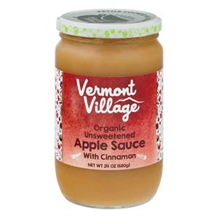
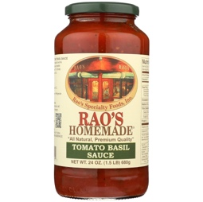
"Mainers Feeding Mainers" Social Benefit Brand - Pilot
Phase I Products (“best-sellers” for Hannaford and Good Shepherd Food Bank):
CLASSIC MAINE APPLE SAUCE
Made with fresh apples grown in Maine region, this apple sauce is a New England favorite! Kettle-cooked the old-fashioned way using chunky whole fruit for a delicious home made taste. With no added sugar, it a great healthy treat for the whole family!! Other flavors include: Cinnamon Apple Sauce, Apple Berry Sauce, Apple Cranberry Sauce
Target: Vermont Village Apple Sauce – APPLES, APPLE PUREE, VITAMIN C
24 oz. glass jar $3.99
CLASSIC MAINE GARDEN MARINARA SAUCE
Our original Maine Garden Marinara Sauce uses a tasty, slow kettle-cooked recipe featuring real fresh Maine grown vegetables that is not only perfect for pasta but also great in many delicious easy meals with meats, seafood, pizza, or casseroles. Flavors include: Classic Maine Garden Marinara Sauce and Sweet Basil Garden Pasta Sauce
Target: Rao’s Homemade Pasta Sauce – Organic Tomato Puree, Organic Diced Tomatoes, EVOO, Carrot Puree, etc.
24 oz. glass jar $6.99/ 32 oz. glass jar $8.99

Slide 9
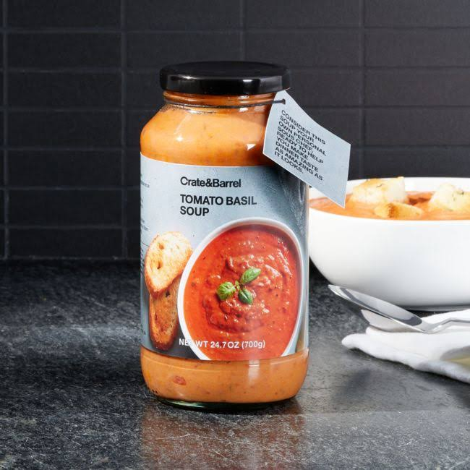
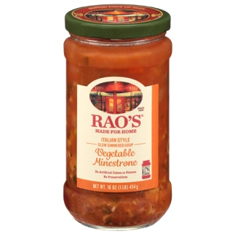
"Mainers Feeding Mainers" Social Benefit Brand - Pilot
Phase II Products (to be developed - not currently ordered by GSFB):
MAINE SOUPS (CREAM AND BROTH-BASED)
Our Maine Cream of Tomato Soup is an elegantly simple combination of fresh tomatoes, cream, basil and black pepper – a
real classic. Other flavors include: Maine butternut squash, Maine cream of broccoli, and Maine potato cheddar
Target: Crate & Barrel - Tomatoes (vine-ripened fresh unpeeled tomatoes, calcium chloride, citric acid), cream, water, butter (cream, salt), basil, modified food starch, salt, black pepper and citric acid
24 oz. glass jar $3.99
MAINE VEGETABLE MINESTRONE SOUP
Our Maine vegetable minestrone is a fresh tomato broth filled with fresh carrots, celery, onions, pasta, potatoes, zucchini, peas, green beans, red kidney beans and chickpeas.
Other flavors include: Downeast Farm Spring Vegetable Soup, Maine Lentil Vegetable Soup
Target: Rao’s Homemade Soup, Trader Joe’s Soup Jars
16 oz. glass jar $3.99

Slide 10
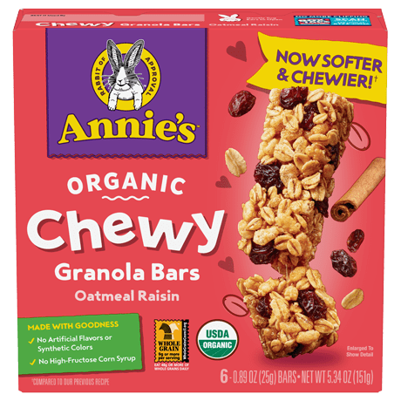
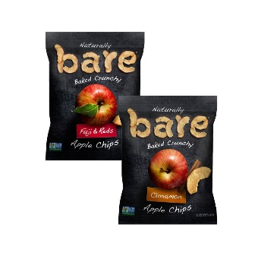
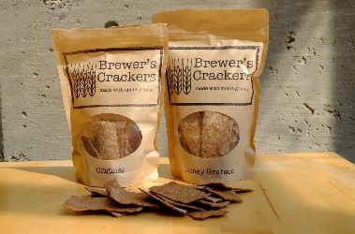
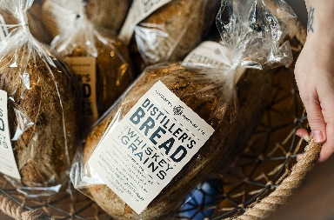
"Mainers Feeding Mainers" Social Benefit Brand - Pilot
Phase II Products (strong potential, but not currently ordered by GSFB):
DEHYDRATED SNACKS (GRAIN SNACK BARS, DRIED FRUIT SNACKS, KID FRUIT SNACK BARS)
SPENT GRAIN BAKERY (BREAD, ROLLS, CRACKERS)
“ I don’t think that I’m making a huge difference…because I’m a very small bakery. But I imagine if Wonder Bread or Dave’s Killer Bread started putting mash in their break, it would make a huge difference.”
- Peg Loughran, owner, Sunnyfield Brick Oven Bakery

Slide 11

Triple Bottom Line Benefits
Feeds all Mainers
Supports healthy Local eating
Build resilience
Ends Food Waste
Protects Natural Resources
Fights Climate Change
Builds Maine Ag Food Economy
Strengthens Farms
Creates Local Food Supply Chain

Slide 12
Next Steps
Present pilot opportunity to Hannaford and GSFB as key retail partners.
Work with key stakeholder partners to develop and test business plan.
Implement, track and measure to prove business success and scalability.
Revise or launch business plan based on pilot results.

