Slide 1



Title
Maine School Cafeteria
Food Waste Study 2023 - Results
Senator George J. Mitchell
Center for Sustainability Solutions
umaine.edu/mitchellcenter l 207.581.3195 l umgmc@maine.edu

Slide 2
Study Overview
Maine School Cafeteria Food Waste Study 2023
Goal: Reduce school cafeteria student food waste and increase student nutrition
Strategy: Work with school nutrition directors to develop a student-directed food waste reduction program.
Select K-5 elementary schools
Pilot schools – varied size & locations: Lisbon, Buxton, Orono, Sebago
Nutrition Director bi-weekly planning meetings
Pre-launch School meetings
Data Tracking & Measuring: Pre/Post Family Data, School Data, Daily FW Tracking (Optional: Kitchen), Pre/Post Food Waste Audits, Kitchen/Custodial Interviews
umaine.edu/mitchellcenter l 207.581.3195 l umgmc@maine.edu

Slide 3
Study Data Assumptions
Key data assumptions:
“Food Waste”: student-generated cafeteria food waste (non-Kitchen waste)
“Wk 1” = “Baseline Week” : represents pre-Study school food waste levels
“Baseline Week”: without Study, food waste would continue at these levels
“Food Waste Per Meal Served” metric:
      Average quantity of food waste produced with each lunch meal served
      Eliminates effect of school size
      Allows comparison of all Maine schools
      Eliminates impact of missed school days or other disruptions to weekly data
umaine.edu/mitchellcenter l 207.581.3195 l umgmc@maine.edu

Slide 4
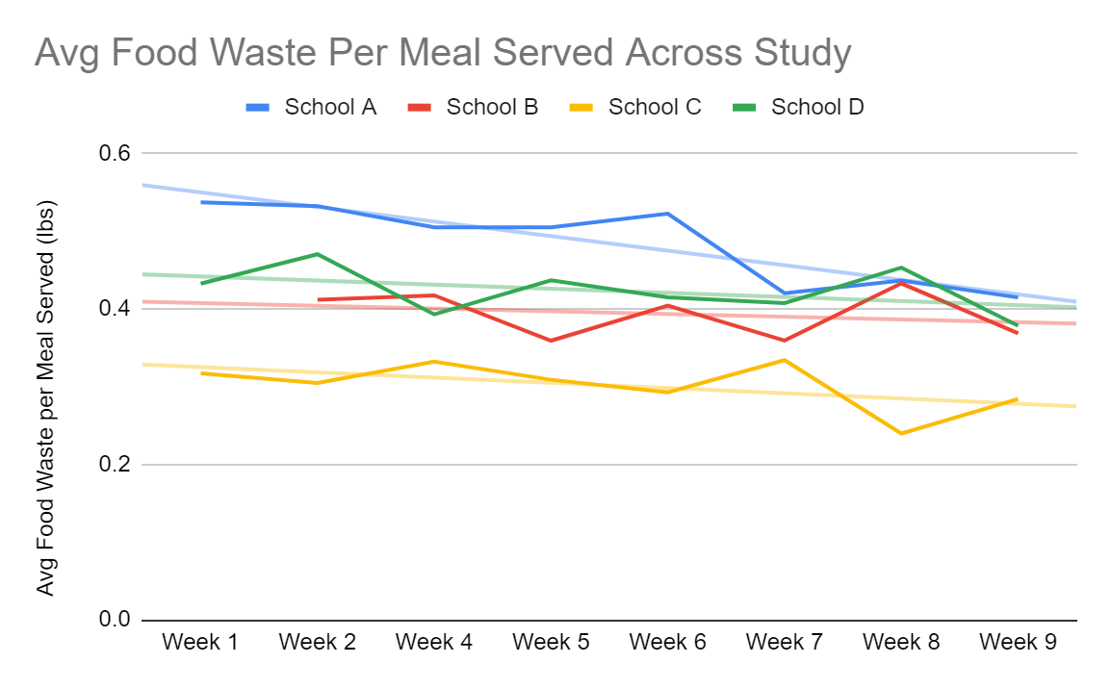
Overall Food Waste Study Result
Pilot schools saw Average Food Waste trend downward by nearly 20% over 9 weeks.
umaine.edu/mitchellcenter l 207.581.3195 l umgmc@maine.edu

Slide 5
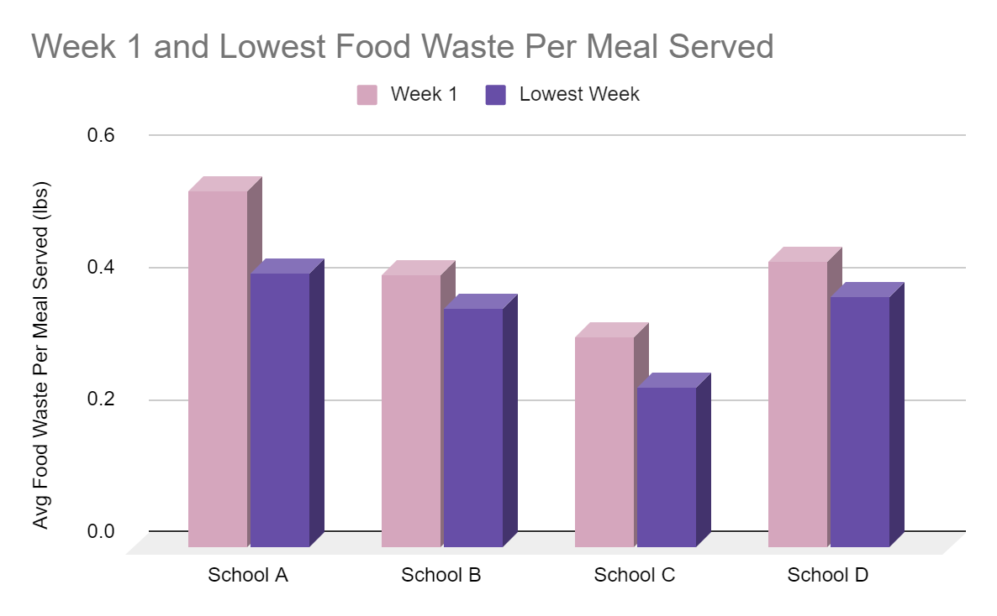
Food Waste: Wk 1 vs Lowest Wk Change *
Comparing Wk 1 to Lowest Week, Pilot Schools reduced their Average Food Waste by 18.1%.
School A: 22.8%
School B: 12.8%
School C: 24.4%
School D: 12.5%
Average: 18.1%
* When comparing the first and lowest week’s waste levels
umaine.edu/mitchellcenter l 207.581.3195 l umgmc@maine.edu

Slide 6
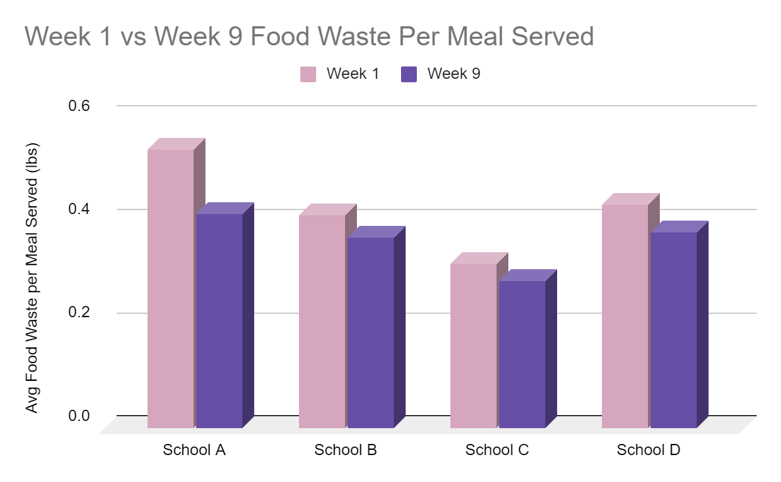
Food Waste: Wk 1 vs Wk 9 Change*
Comparing Wk 1 to Wk 9, Pilot Schools reduced their Average Food Waste by 14%.
School A: 22.8%
School B: 10.5%
School C: 10.4%
School D: 12.5%
Average: 14%
*Comparing Baseline to final Wk 9 food waste levels
* Uses Week 2 data for School B as tracking was not reported on week 1
umaine.edu/mitchellcenter l 207.581.3195 l umgmc@maine.edu

Slide 7
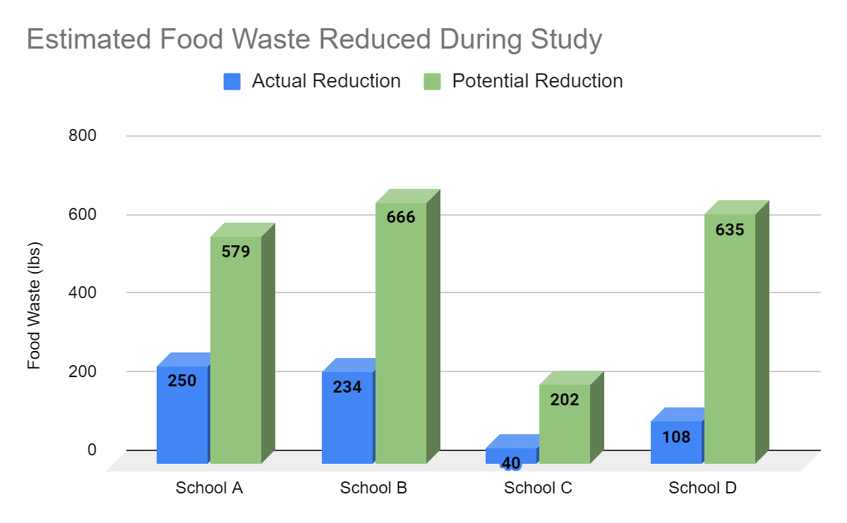
Food Waste: Total Food Saved
During the Study, the four schools actually saved over 630 lbs. of food.
School A: 250.4 lbs
School B: 233.9 lbs
School C: 40 lbs
School D: 107.7 lbs
Maintaining their highest level of food waste reduction, the four schools could have saved more than 1 ton of food.
School A: 578.7 lbs
School B: 666.2 lbs
School C: 201.9 lbs
School D: 634.9 lbs
Over eight weeks, the four Pilot Schools saved over 630 lbs. of Food – over ¼ ton!
* Compared To “Baseline” Food Waste Levels
umaine.edu/mitchellcenter l 207.581.3195 l umgmc@maine.edu
Notes:
anonymity

Slide 8
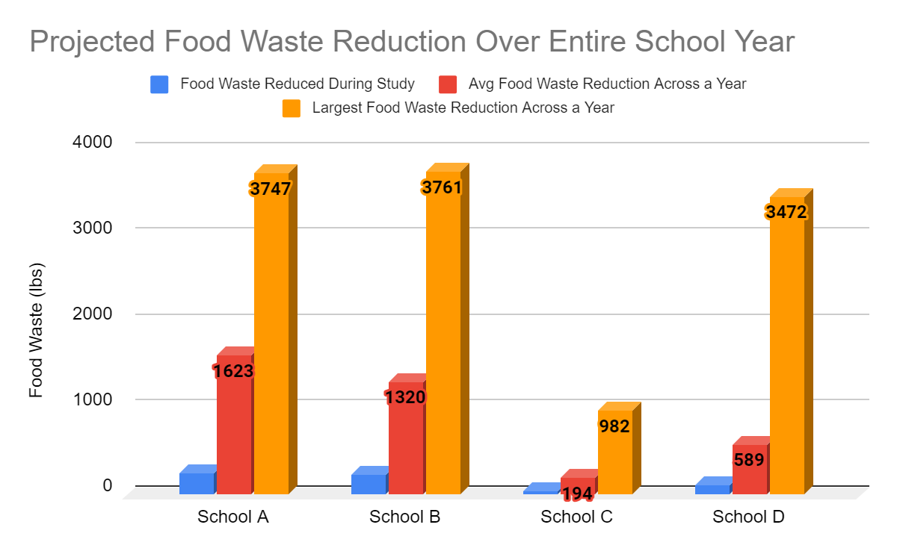
Projection: Food Saved Annually
Maintaining average food waste reduction rates, one Pilot School could save almost a ton of food annually.
Maintaining their average food waste reduction rate, one pilot school could save almost one (1) ton of food annually.
School A: 250.4lbs --- 1,623.3 lbs
School B: 233.9lbs --- 1,320.2 lbs
School C: 40lbs --- 194.4 lbs
School D: 107.7lbs --- 589.2 lbs
By maintaining their highest food waste reduction rate, one pilot school could save almost two (2) tons of food annually.
School A: 578.7 --- 3,746.9 lbs
School B: 666.2 --- 3,760.7 lbs
School C: 201.9 --- 981.7 lbs
School D: 634.9 --- 3,472.3 lbs
* Compared To “Baseline” Food Waste Levels
umaine.edu/mitchellcenter l 207.581.3195 l umgmc@maine.edu

Slide 9
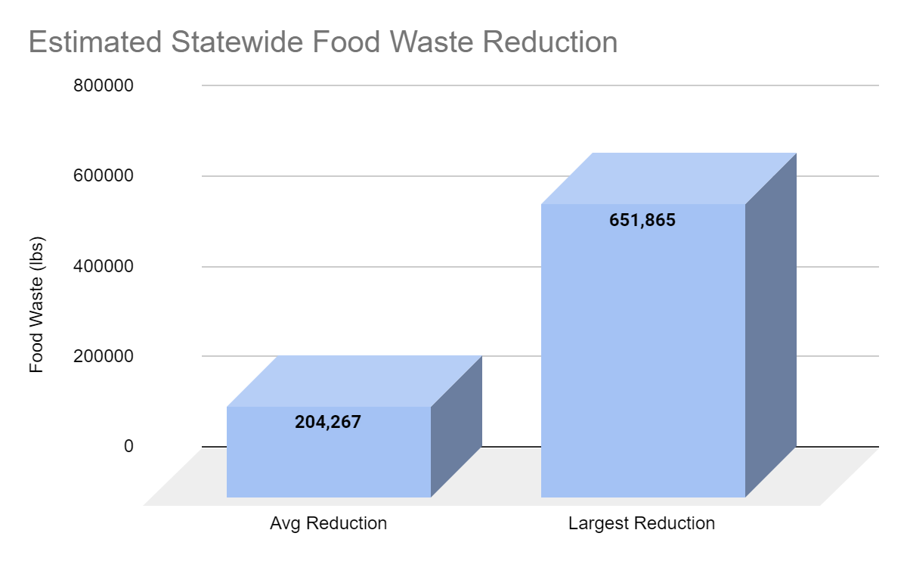
How Much Food Could Maine Schools Save?
If every Maine elementary school achieved the average food waste reduction rate for one full school year,
204,267 lbs or 102 tons of food could be saved.
If every Maine elementary school achieved the highest food waste reduction rate for one full school year,
651,865 lbs or 325 tons of food could be saved.
umaine.edu/mitchellcenter l 207.581.3195 l umgmc@maine.edu

Slide 10
Triple Bottom Line Impact?
Average
204,267 lbs of School Food Waste
Estimated $510,668 of Food saved per year*
Estimated 3194 tons of CO2 reduced per year** (climate impact of 700 passenger vehicles)
Estimated 170,223 extra meals per year***
High
651,865 lbs of School Food Waste
Estimated $1,629,663 of Food saved per year*
Estimated 4263 tons of CO2 reduced per year** (climate impact of nearly 1000 passenger vehicles)
Estimated 543,221 extra meals per year***
  * Using ReFED Retail Value of 1 lb. of Food = $2.50/lb
  ** ReFED CO2e Emissions Impact Calculator, using total food waste
  *** USDA Average Meal Weight Calculator
umaine.edu/mitchellcenter l 207.581.3195 l umgmc@maine.edu

Slide 11
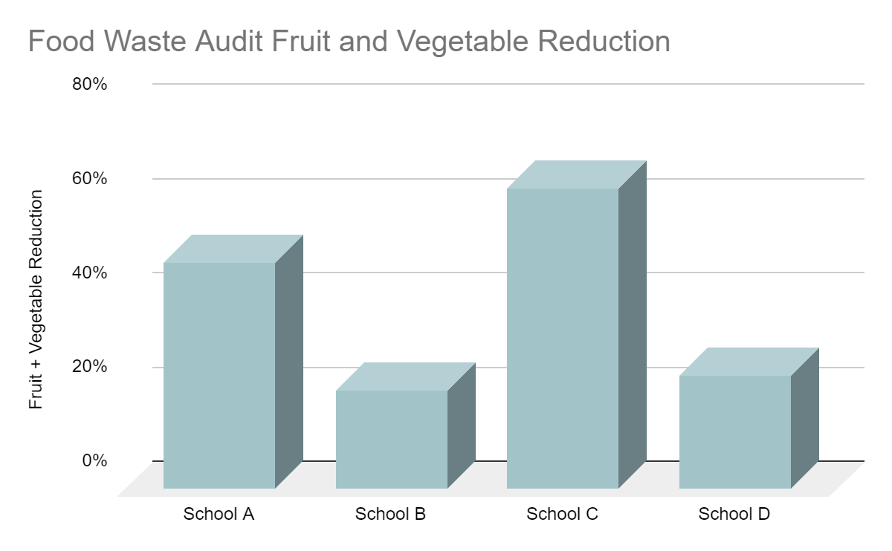
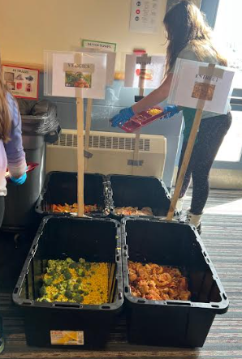
Student Nutrition Impact
Pilot schools reduced fruit & veggie waste from 21% to 64%.
Fruit and veggies
achieved the
highest food
waste reduction
rate.
umaine.edu/mitchellcenter l 207.581.3195 l umgmc@maine.edu

Slide 12
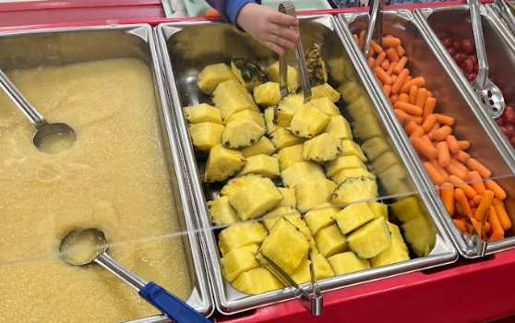
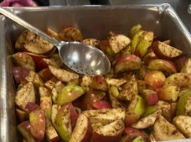
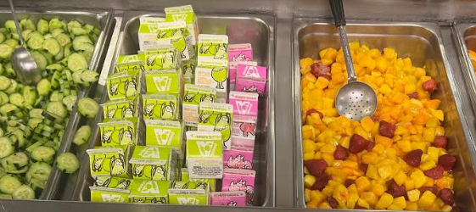
Student Nutrition Impact
umaine.edu/mitchellcenter l 207.581.3195 l umgmc@maine.edu
Notes:
if you cut/core your apples and soak them in a lemon bath they won't brown and definitely get eaten more, taking grapes off stems, wedging oranges, dicing melon.
For schools that served packaged or whole fruit, some of the fruit & veggie reduction could be due to Share Basket recovery.
In future studies, we should measure the Share Basket fruit & veggies at the end of the day to assess whether the overall reduction of food waste is due to eating or sharing.
a lot of success with baby carrots or sliced red bell peppers, starchy is tough to do fresh but a potato salad made in house usually goes well. I think all children like sugar snap or snow peas fresh with dip or cucumbers, also cherry tomatoes. Fruits are what you expect, apples, oranges, cut melon, canned pineapple, plums, peaches in season, grapes etc..

Slide 13
Qualitative Results: School Cafeteria Interviews
“Encourage food waste reduction by educating. I think that’s the biggest piece that we’re all missing. It’s the most important piece.”
-Morgan Therriault, Nutrition Director at Sebago Elementary
“Not having liquid in the trash can makes the bag much lighter. It makes my whole job easier.”
-Aaron Putnam, Janitorial Staff at Asa Adams Elementary
“Allowing the students to choose which fruit or vegetable they wanted resulted in less waste because they picked something they liked and wanted to eat.”
-Laurie Rufo, Kitchen Staff at Asa Adams Elementary
umaine.edu/mitchellcenter l 207.581.3195 l umgmc@maine.edu
Notes:
I think if you have a core of students/staff or community that are looking to reduce food waste composting or utilizing the food waste is a no brainer. The impact on the custodial staff was surprising to them I do believe, they were against it but soon realized it made their jobs emptying trash a whole lot cleaner and easier. We started diverting food waste prior to the study at the high school and diverted food waste to create biogas via Agricycle. That's one small district of approx 800 kids, imagine that on an even county level let alone statewide. It's a small buy-in for kids to do something good while basically doing what they were doing anyway, but just putting it in a different bin. Ben Johnson, Nutrition Director – Orono School District

Slide 14
Qualitative Results: School Cafeteria Interviews
“I think if you have a core of students/staff or community that are looking to reduce food waste composting or utilizing the food waste is a no brainer.
The impact on the custodial staff was surprising to them I believe. They were against it, but soon realized it made their jobs emptying trash a whole lot cleaner and easier.
We started diverting food waste prior to the study at the high school and diverted food waste to create biogas via Agricycle. That's one small district of approx 800 kids, imagine that on an even county level let alone statewide.
It's a small buy-in for kids to do something good while basically doing what they were doing anyway, but just putting it in a different bin.”
Ben Johnson, Nutrition Director- Orono School District
umaine.edu/mitchellcenter l 207.581.3195 l umgmc@maine.edu
Notes:
I think if you have a core of students/staff or community that are looking to reduce food waste composting or utilizing the food waste is a no brainer. The impact on the custodial staff was surprising to them I do believe, they were against it but soon realized it made their jobs emptying trash a whole lot cleaner and easier. We started diverting food waste prior to the study at the high school and diverted food waste to create biogas via Agricycle. That's one small district of approx 800 kids, imagine that on an even county level let alone statewide. It's a small buy-in for kids to do something good while basically doing what they were doing anyway, but just putting it in a different bin. Ben Johnson, Nutrition Director – Orono School District

Slide 15

Qualitative Results: School Family Survey
45% post-Study increase in “students talking to family about food waste”.
Strong Response Rates
Overwhelmingly Positive Support for Food Waste
umaine.edu/mitchellcenter l 207.581.3195 l umgmc@maine.edu

Slide 16
Qualitative Results: School Family Survey
Family Comments
Thank you for running this program! Though my child hasn't brought home the discussion yet, I am very appreciative that she is being exposed to it at the school.
Great thing to teach children about
They did talk about it. What a great idea
Glad this is something being discussed at school.
I really hope this assists in reducing food waste in schools.
She wanted to know more about what our thoughts are and if we currently do anything to help it.
Thanks for working with our students! I hope it continues in the future!
My child is trying to create less food waste at home.
Thank you for making space for this topic!
Our children have talked often about the food waste program at school in the cafeteria and seem really excited about it.
I wish more schools would take up these practices.
  And many more…
umaine.edu/mitchellcenter l 207.581.3195 l umgmc@maine.edu

Slide 17
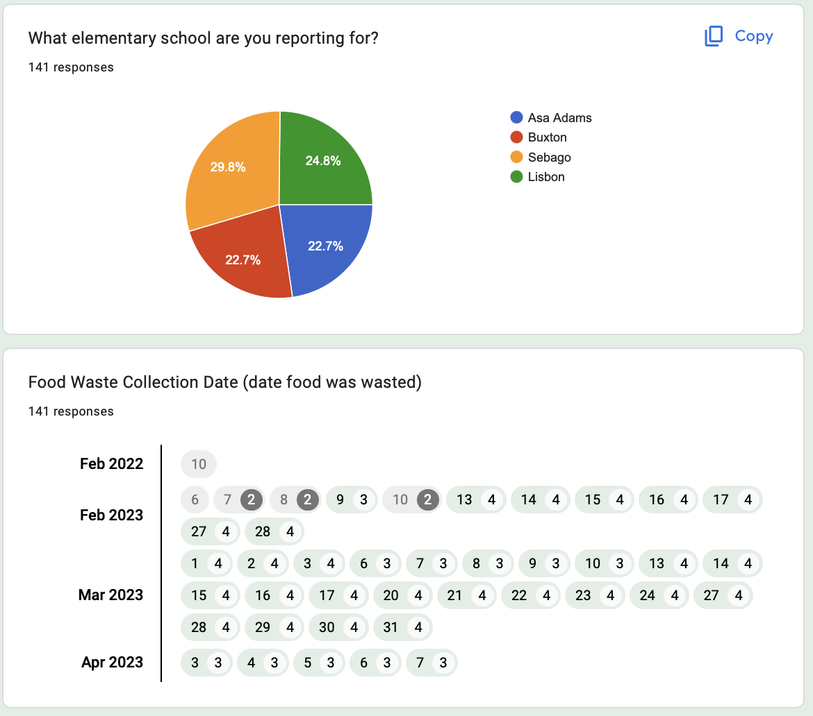
Moving Forward: Data Tracking
Consider longer data tracking period
Establish “Baseline” using 2 or 3 weeks of data
Consider collecting some Share Basket data
Record daily menu data
Use consistent menus to better compare impact
Use periodic audits to check progress
umaine.edu/mitchellcenter l 207.581.3195 l umgmc@maine.edu

Slide 18
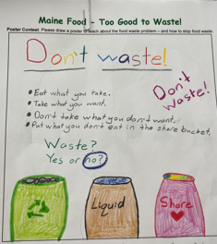
Moving Forward: School Solutions
Maine Food Waste Education
  Proclaim annual Maine Food Waste Awareness Week in Sept.
      Hold K-5 School Food Waste Assemblies/Activities
      Create 4th/5th Grade Student Green Teams to facilitate:
Share Baskets: Use Share Baskets to recover good, edible food.
Waste Sorting: Set up simple sorting station in all schools
Offer vs. Serve: Provide kid-friendly sizes and choices of fruits & veggies.
Donation: Recover all good, edible food to feed community – school “freedge”, pantry, etc.
Recycling: Compost or use food waste hauler to recycle remaining inedible food scraps.
umaine.edu/mitchellcenter l 207.581.3195 l umgmc@maine.edu

Slide 19
2023 Maine School Cafeteria Food Waste Study
Additional School Food Waste Resources:
NRCM’s Sustainability Grants program is currently accepting applications. Deadline to apply is 10/13/23.
Maine Climate Hub with Food Waste Resources https://www.meeassociation.org/minigrants-for-outdoor-learning
UMaine/Mitchell Center Food Rescue MAINE website umaine.edu/foodrescuemaine with school resources, compost services, other food waste solutions.
Thank You!
umaine.edu/mitchellcenter l 207.581.3195 l umgmc@maine.edu
Notes:
Jane McLucas and DOE for support and insights, Ryan Parker/FoodCorps also for sharing school food programs experience, NRCM for grant which provided materials for the study and Agricycle who supported the Study by providing food waste pick-up services…and of course our terrific participating schools and nutrition directors – Morgan Thierault – Sebago, Dottie Janotta/Erin Miller at Buxton Center, Ben Johnson – Asa Adams, and one of our hosts today Allison Leavitt, Lisbon Community School!

Slide 20
Slides past this point are not planned to be included in final presentation or are backup slides to refer back to

Slide 21
For Discussion…
Issues to Explore:
Track specific daily menu items? lunch time period? other food waste factors?
Expand existing interventions? Add other interventions?
How to measure impact of Share Basket (donation vs. reduction)?
How to measure cost of food waste? (triple bottom line metrics)
Include kitchen/custodial staff in pre-planning?
Include principal/faculty in pre-planning?
Identify 4th/5th grade Green Team?
      Sustainability Next Steps:
      Create Back-to-School Food Waste Assembly – Gov. Declaration of Food Waste Awareness Day?
      Create Bi-Annual Food Waste Audit Plan?
      Add recycling/packaging waste reduction?
      Add kitchen waste/food donation?
      Add on-site composting?
      How best to expand to more schools?
umaine.edu/mitchellcenter l 207.581.3195 l umgmc@maine.edu

Slide 22
Study Overview
School Food Waste Problem
Maine schools produce more than 7 million lbs. of food waste annually (NRCM 2019).
Harvard public health study shows 60% of veggies/40% of fruit are wasted in U.S . schools.
U.S. school revenue losses and food waste will cost schools nearly $5 million/day, according to the same study.
Food waste is also a nutrition loss for Maine’s 1 in 7 food insecure kids.
Residential food waste is the largest component of food waste (63%).
Schools reflect society’s food waste problem – how to fix?
umaine.edu/mitchellcenter l 207.581.3195 l umgmc@maine.edu

