Slide 1



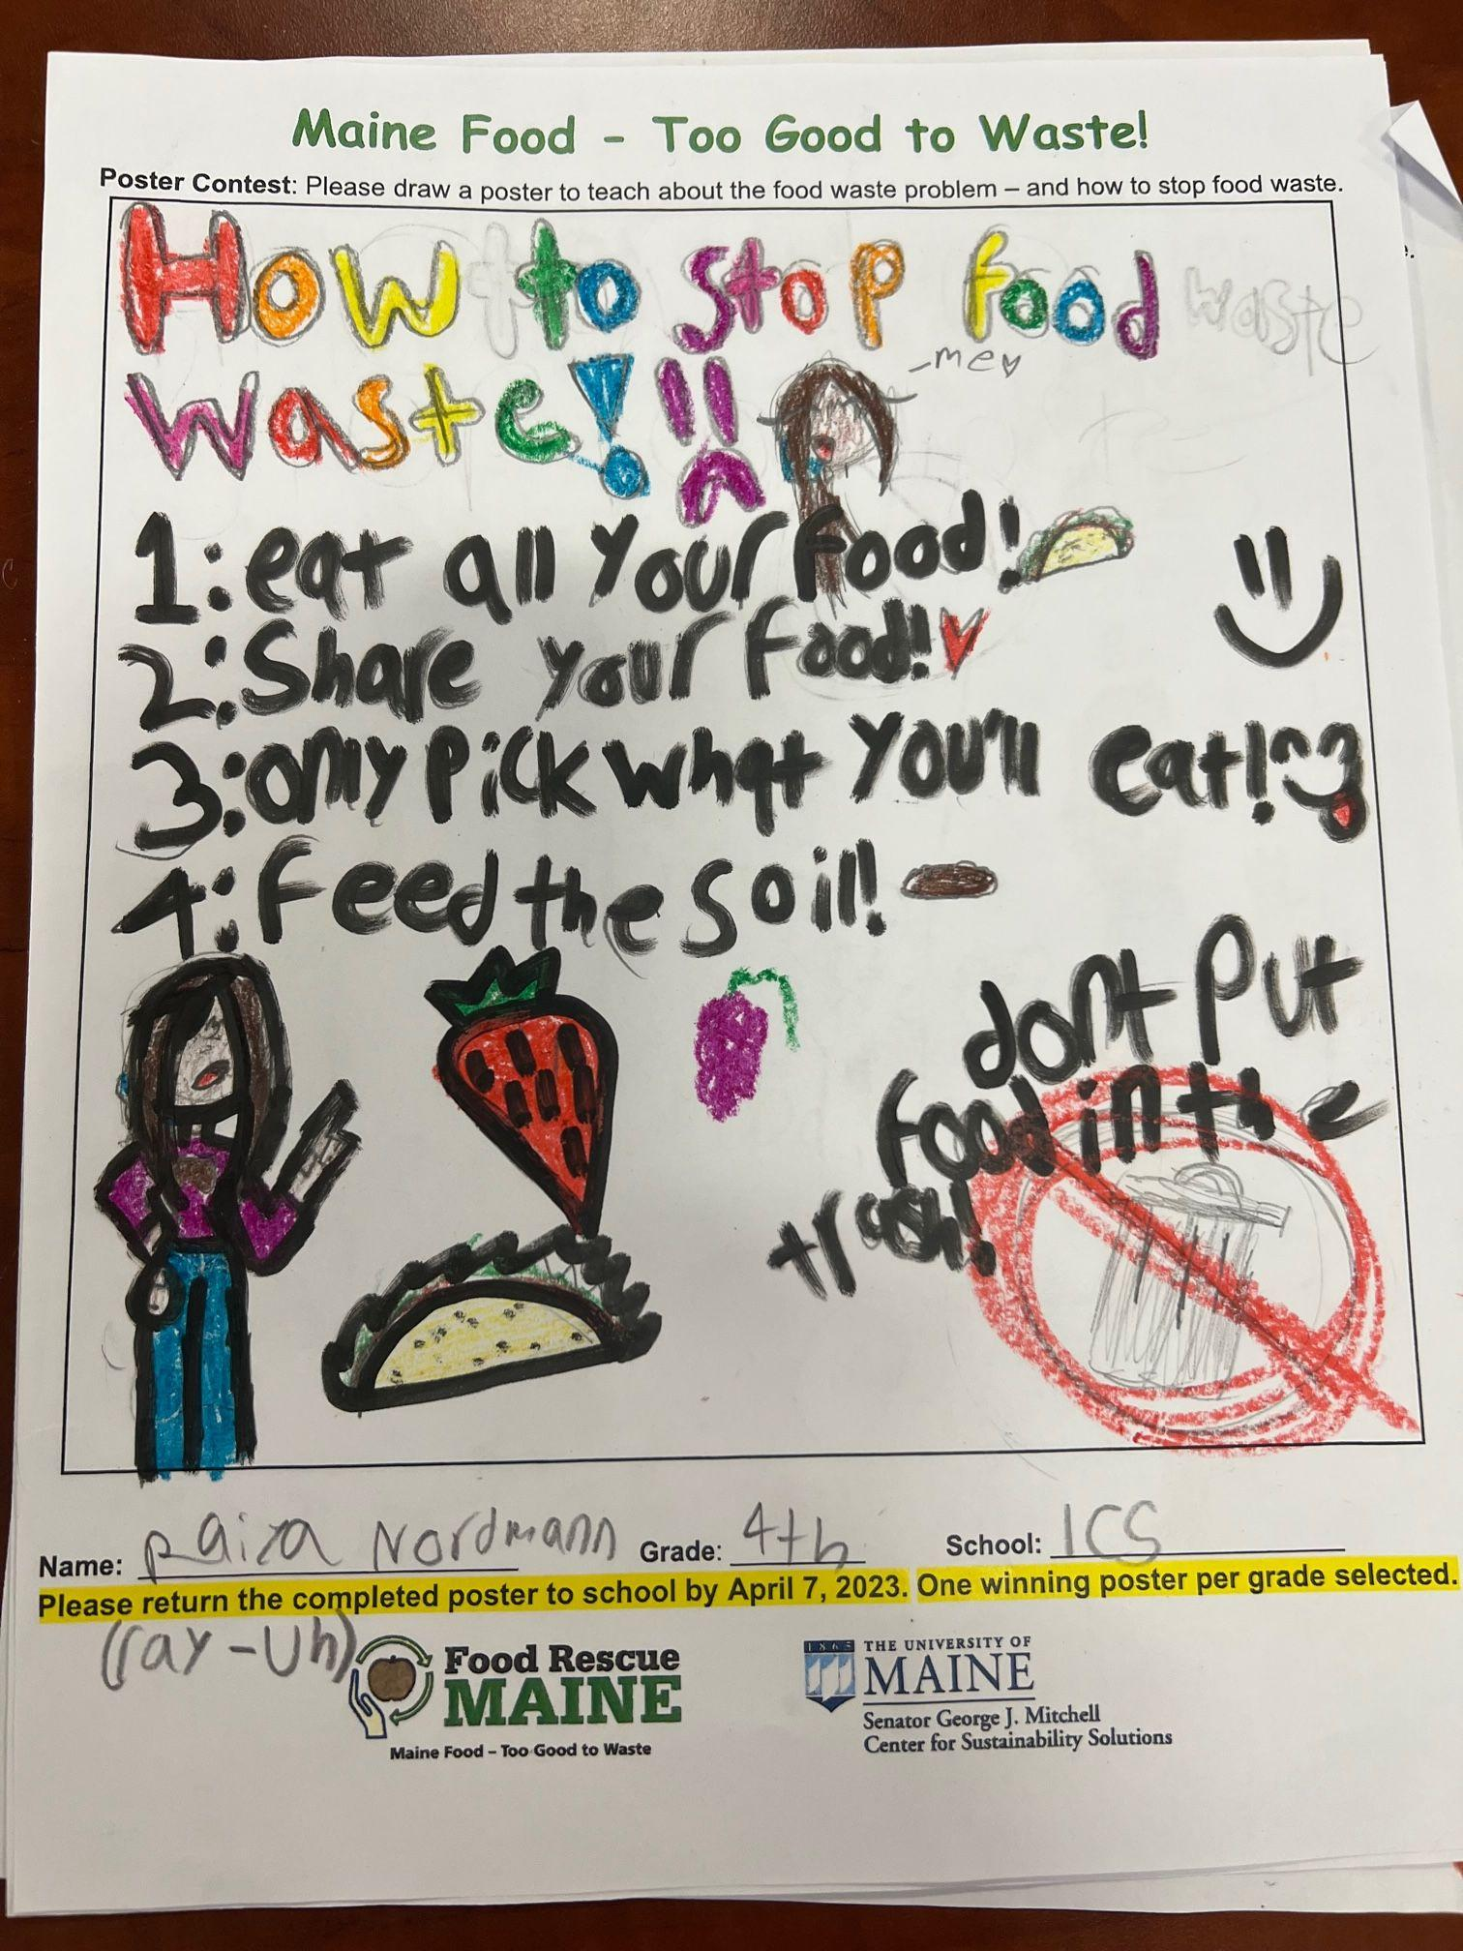
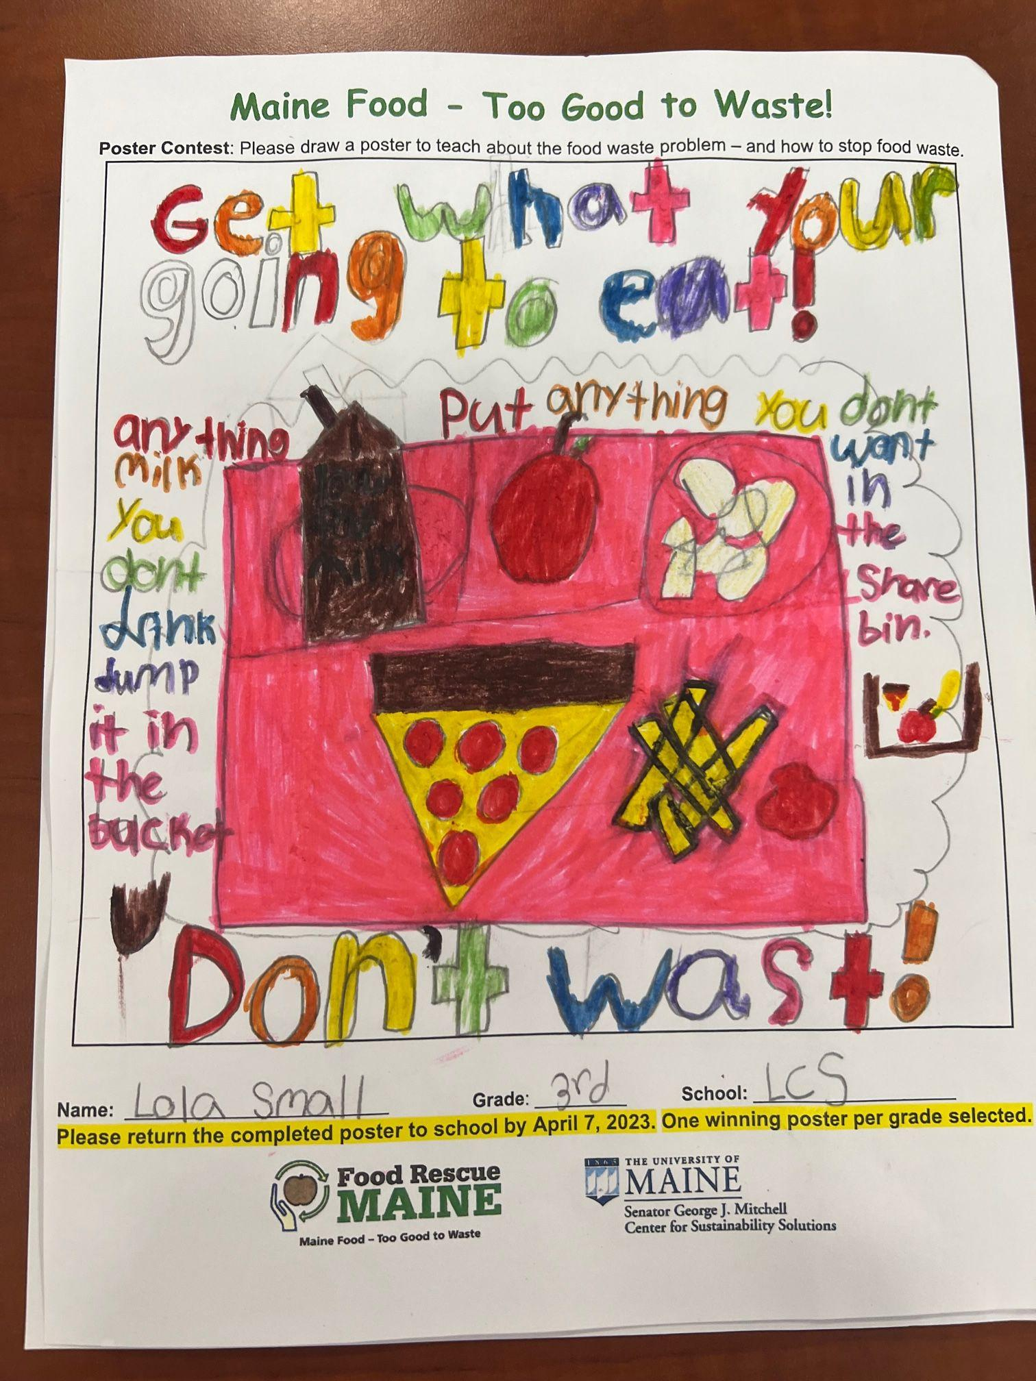
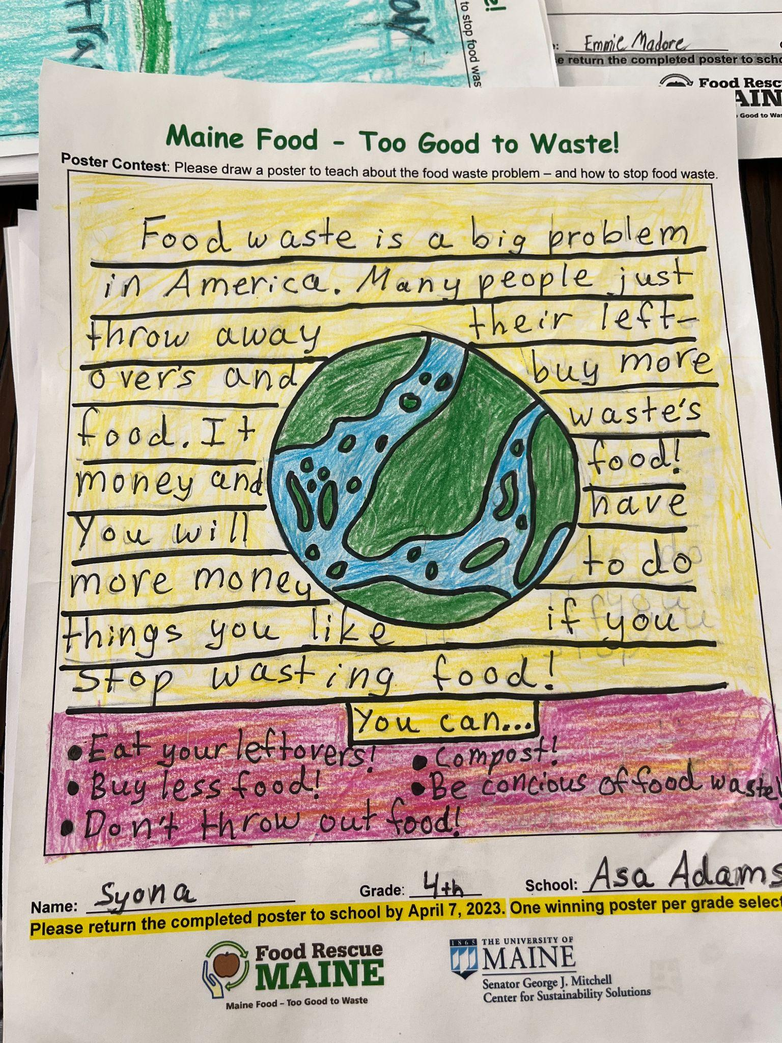
Maine School Cafeteria Food Waste Study 2023
Senator George J. Mitchell
Center for Sustainability Solutions
umaine.edu/mitchellcenter l 207.581.3195 l umgmc@maine.edu
Notes:
My name is Eddie Nachamie, I’m a first year student at UMaine Orono studying Ecology and Environmental Sciences working on Solution 3.

Slide 2
Maine Elementary School Cafeteria Food Waste Study
School Food Waste Problem
School food waste will cost U.S. schools nearly $5 million/day, according to a Harvard Public Health Study
The same study shows 60% of veggies/40% of fruit are wasted in U.S . schools.
Maine schools produce more than 7 million lbs. of food waste annually (NRCM 2019). Food waste is a leading cause of climate change.
Food waste is also a nutrition loss for Maine’s 1 in 5 food insecure kids. (Good Shepherd Food Bank)
WWF and ReFED identify youth education as a powerful tool to reduce food waste.
Schools reflect society’s food waste problem – how to fix?
umaine.edu/mitchellcenter l 207.581.3195 l umgmc@maine.edu
Notes:
1 out of 8 adults, 1 out of 5 children
Emphasize importance of educating K-5 children about food waste – they are powerful home food waste “voices”, can carry learning to middle and high school, and they are Maine’s future!

Slide 3
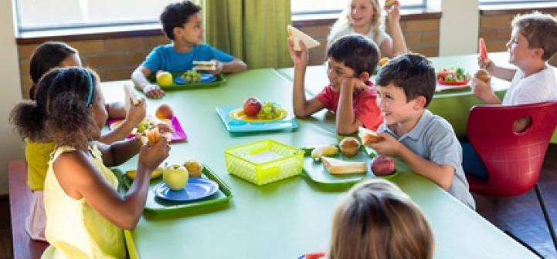
Maine Elementary School Cafeteria Food Waste Study
What did we do?
Objectives:
Reduce student food waste
Improve student nutrition (reduce fruit & veggie waste)
Strategy:
Use student-directed, food waste reduction interventions.
umaine.edu/mitchellcenter l 207.581.3195 l umgmc@maine.edu
Notes:
In January of 2023, we worked with Maine DOE – Nutrition Director to identify four Maine K-5 elementary schools – Asa Adams Elementary, Buxton Center Elementary School, Lisbon Community School, and Sebago Elementary School – representing different school sizes (from just over 100 students to well over 600 students) and locations in state. We added food waste sorting stations at all schools (Sebago already had food waste sorting) to allow us to weigh the food and liquid waste each day for the eight weeks of the study. In this way, we were able to measure the change in food waste due to our student directed interventions. Unfortunately, the variation in foods served will still account for higher and lower levels of waste (think: pineapple rinds) but strong trends still emerged.

Slide 4
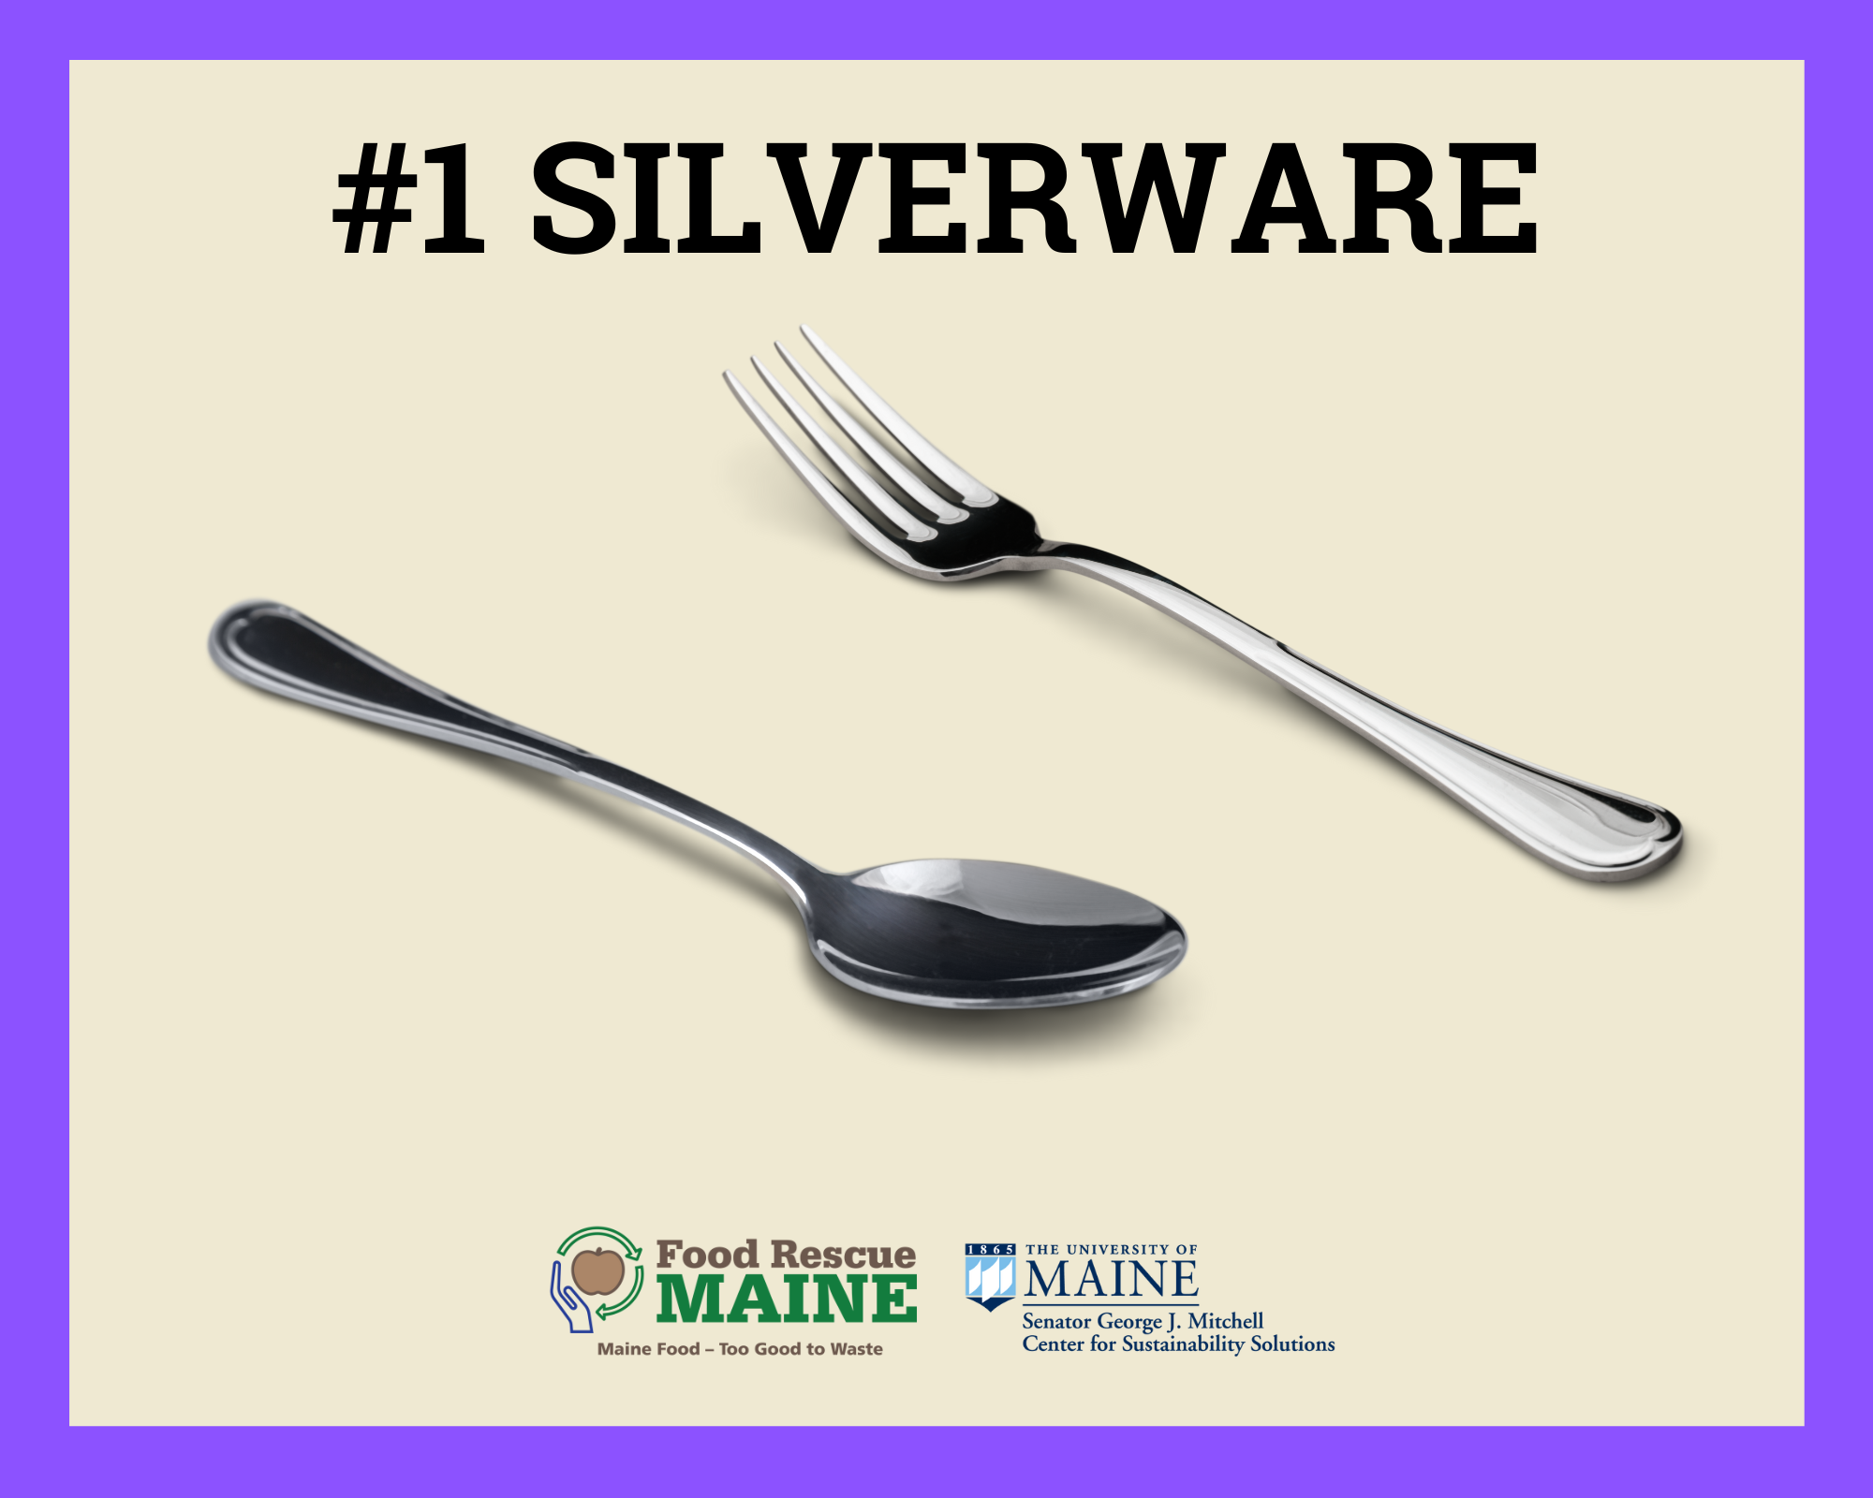

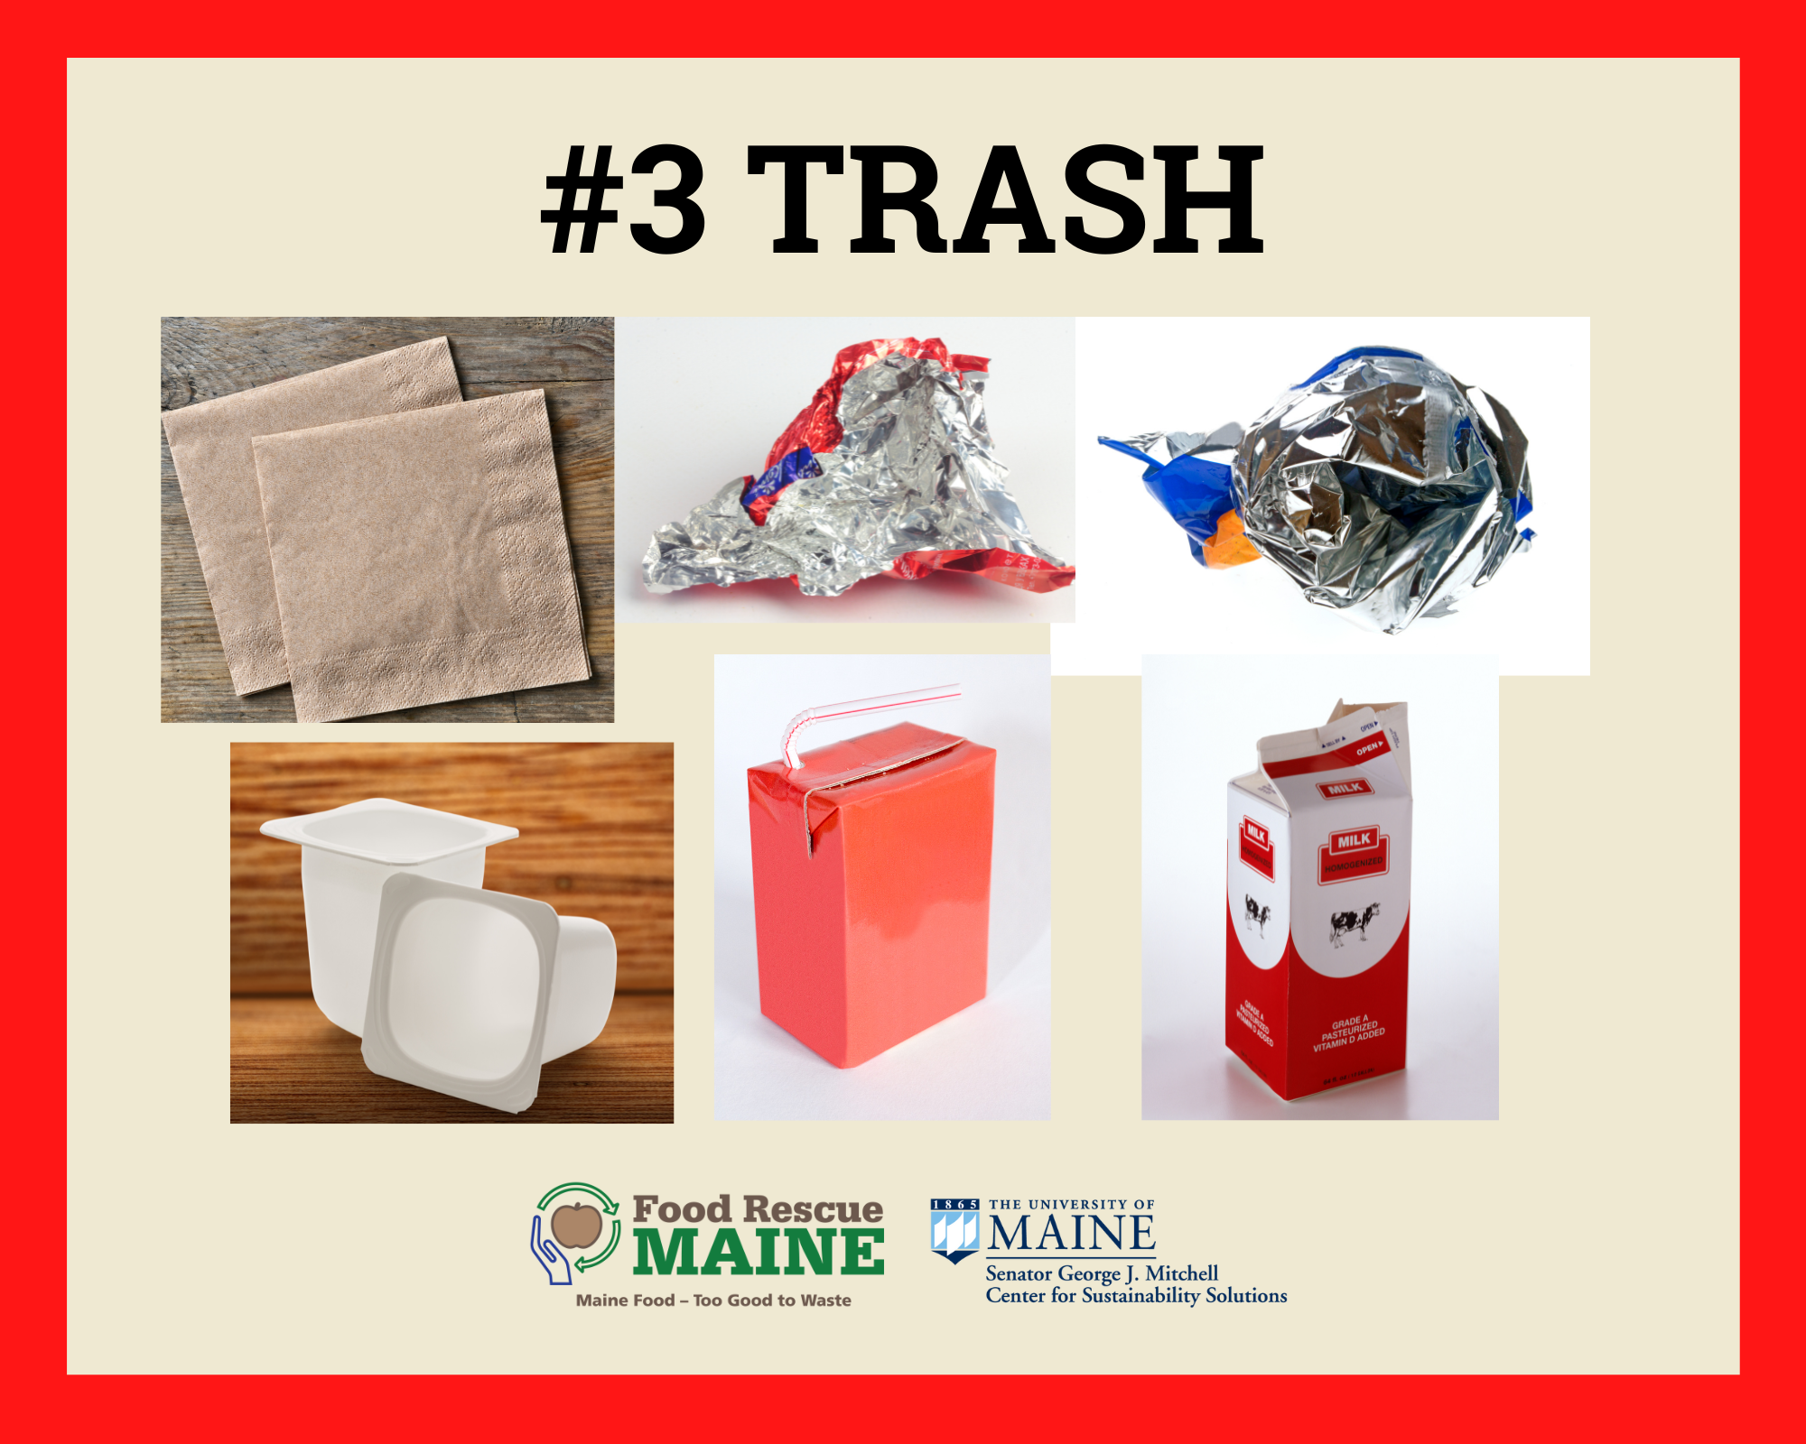
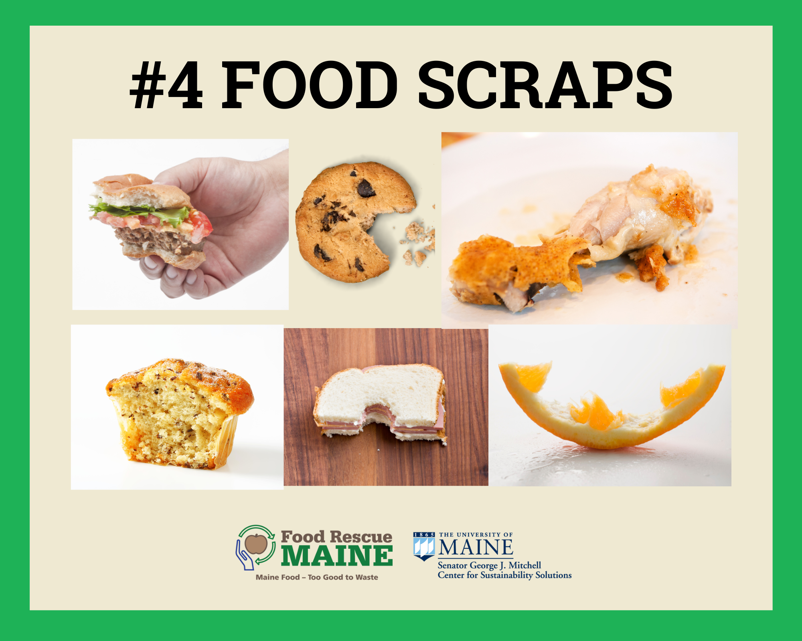
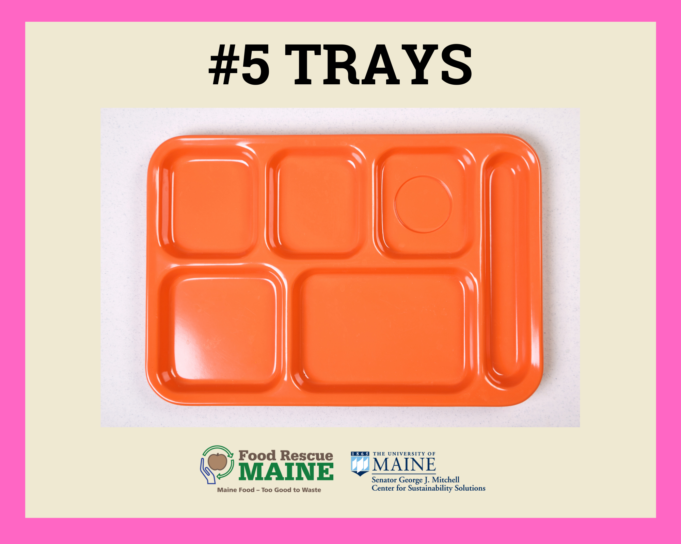
Maine Elementary School Cafeteria Food Waste Study
1) Easy Sorting Stations
umaine.edu/mitchellcenter l 207.581.3195 l umgmc@maine.edu
Notes:
The sorting station was used in order to allow us to collect data on the amount of food waste children were producing at the four elementary schools involved in our study. By using signs with visuals and numbers, it made the waste stops easy for students to identify. With a brief during lunch explanation of the labeled stations along with volunteer 4th/5th grade “helpers” to encourage students at the sorting stations for the first week, students caught on quickly – and enjoyed mastering the sorting process. The biggest challenge was separating packaged food – the packaging into trash bin, and the food into food scraps bin.

Slide 5
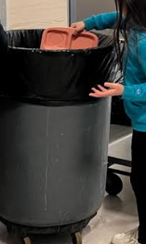
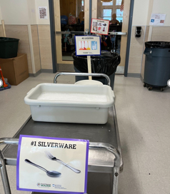
Maine Elementary School Cafeteria Food Waste Study
1) Easy Sorting Stations
umaine.edu/mitchellcenter l 207.581.3195 l umgmc@maine.edu
Notes:
Sorting stations need the signage with visuals and numbers to show what order. Also, consider student-accessible heights and in this example students could make two lines on each side to allow faster flow. Using multiple sorting stations is another option, depending on school size. Also, it is best to dismiss tables to encourage students to take time to eat their lunch and to not mob the waste sorting station, but otherwise even our largest 400+ student schools did not have trouble using the sorting stations to sort their waste. Finally, all our schools recycled their separated food scraps using pig farmers, a food waste collection service, or on-site school district garden/compost programs to insure that no food went to the dumpster/landfill – eliminating GHG production and climate impact.

Slide 6
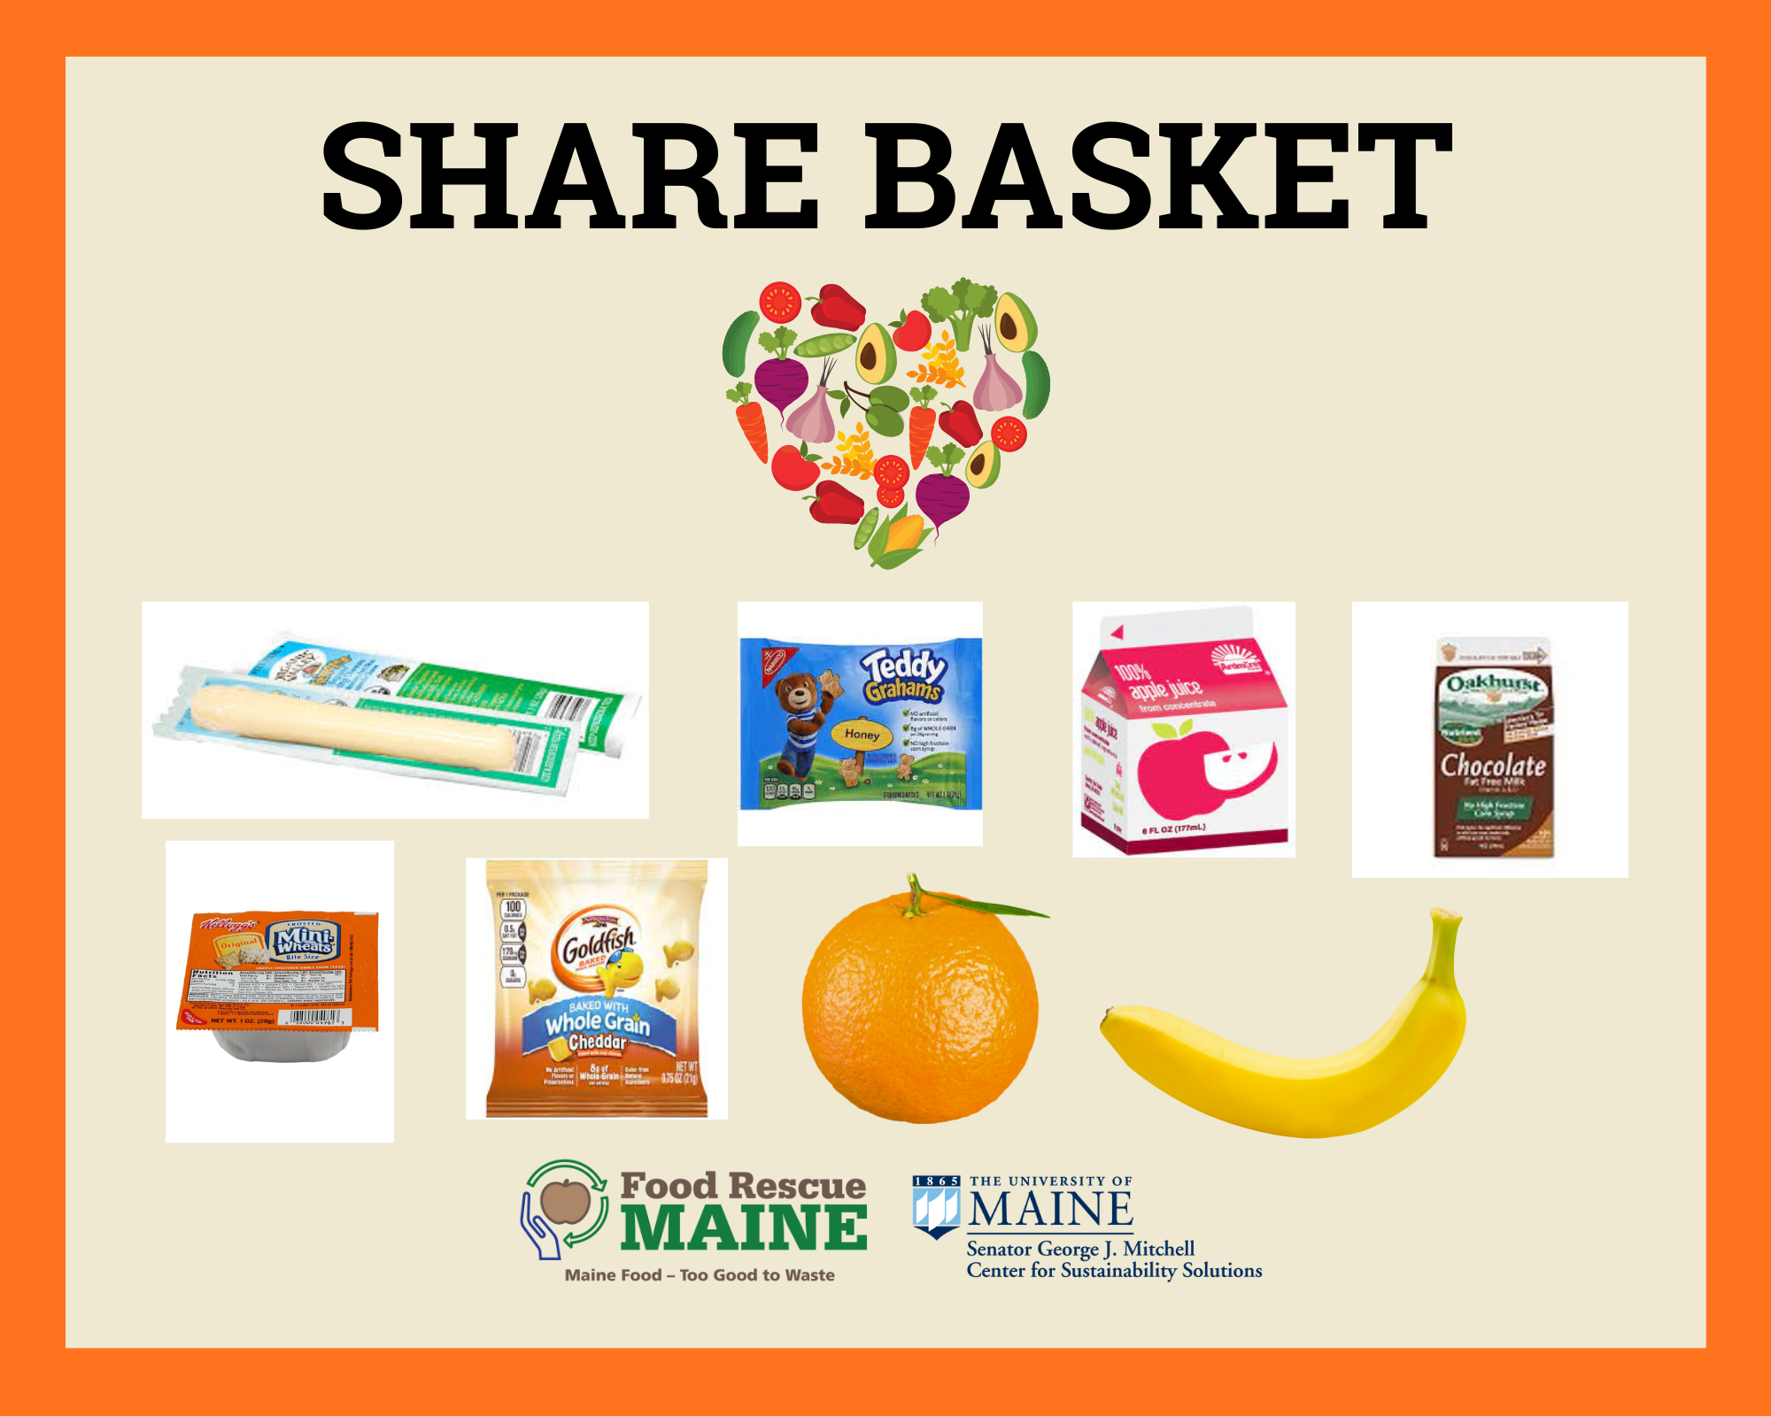
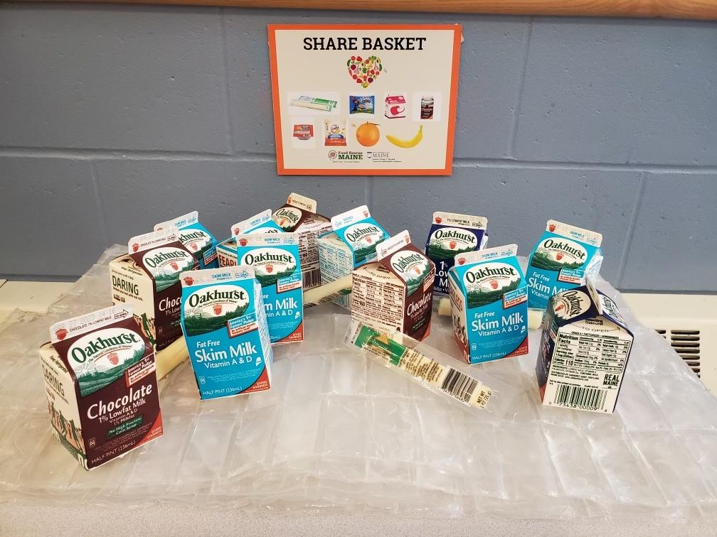
Maine Elementary School Cafeteria Food Waste Study
2) Share Baskets
umaine.edu/mitchellcenter l 207.581.3195 l umgmc@maine.edu
Notes:
The share basket is a tool for diverting perfectly good, edible food away from the landfill. This is a basket with ice packs inside it to keep the food at the proper temperature. We produced kitchen signage from the Maine Health Department encouraging and providing guidance on the proper use of the Share Basket. Children can put unopened snacks like crackers or fruit cups inside it so that other students may take more if they’re hungry. Any leftovers in the Share Basket can be brought back into the kitchen or donated = no waste!

Slide 7
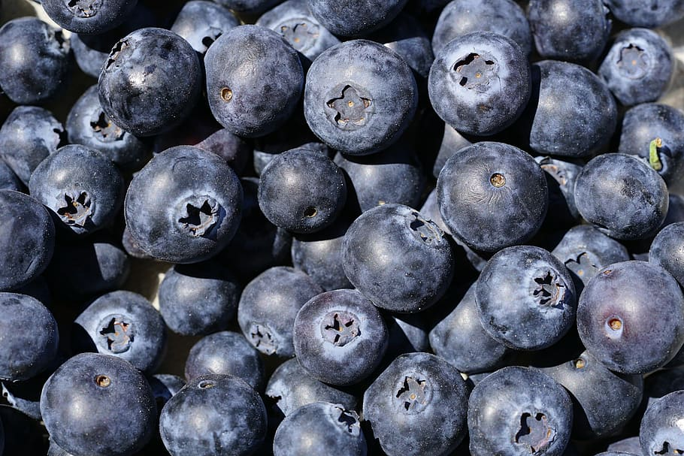
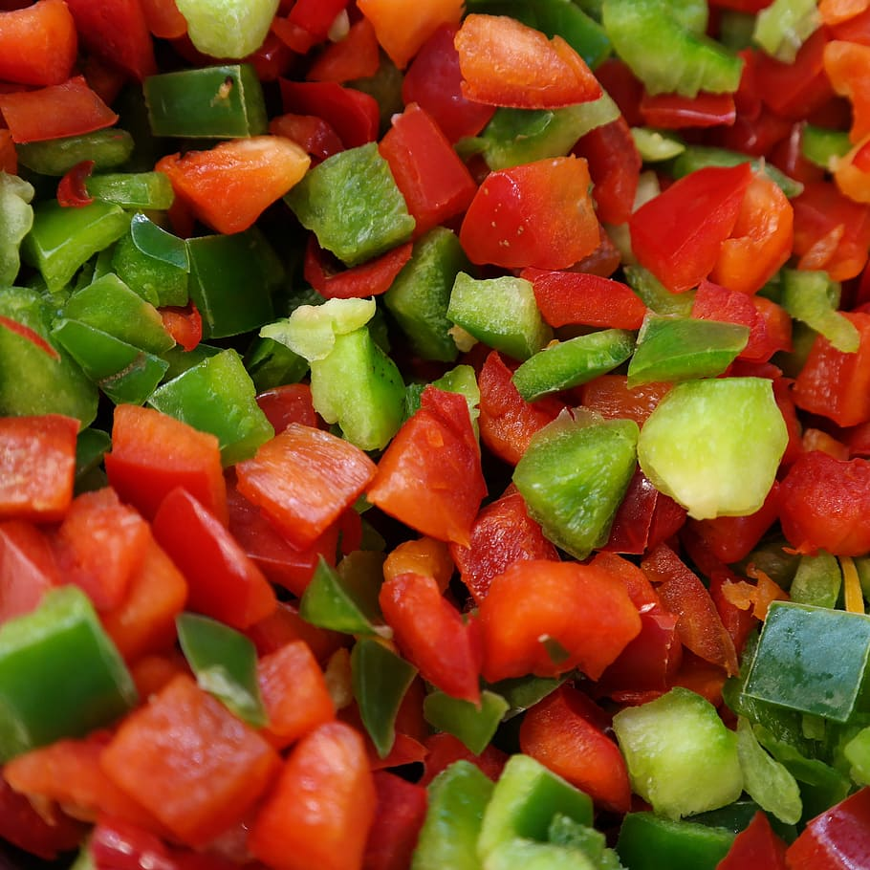
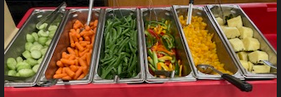
Maine Elementary School Cafeteria Food Waste Study
3) Choice
umaine.edu/mitchellcenter l 207.581.3195 l umgmc@maine.edu
Notes:
We also made sure to add the option of fruit and vegetable choice at the different elementary schools we worked with. By giving children multiple options for fruits and vegetables, including cut fruit & veggies vs. whole fruit & veggies and adding dips & sprinkles. Students are more likely to choose what they like and therefore to eat them.

Slide 8
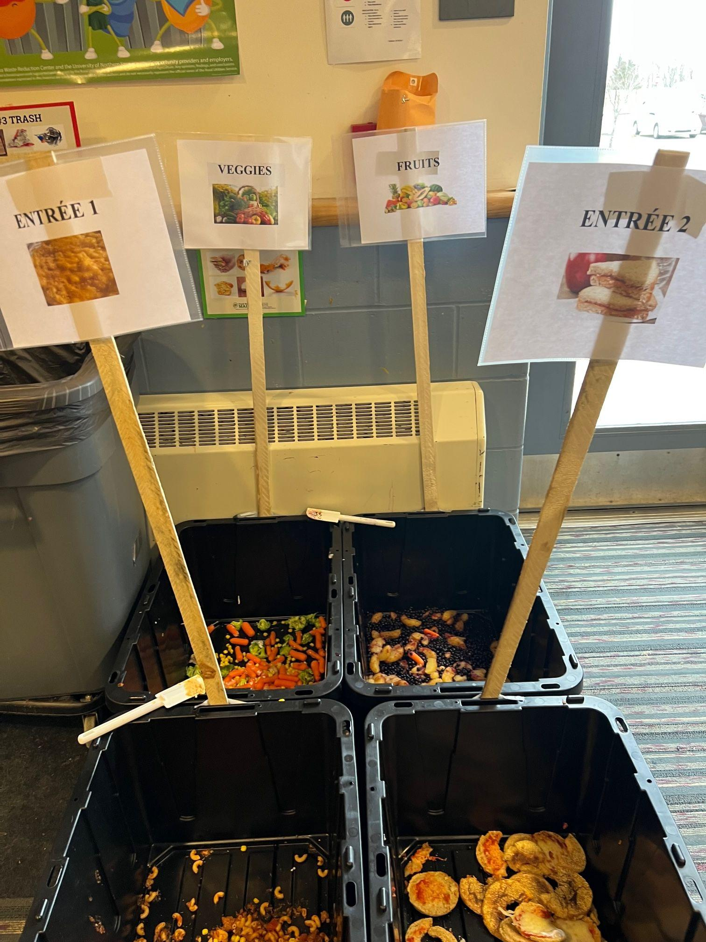
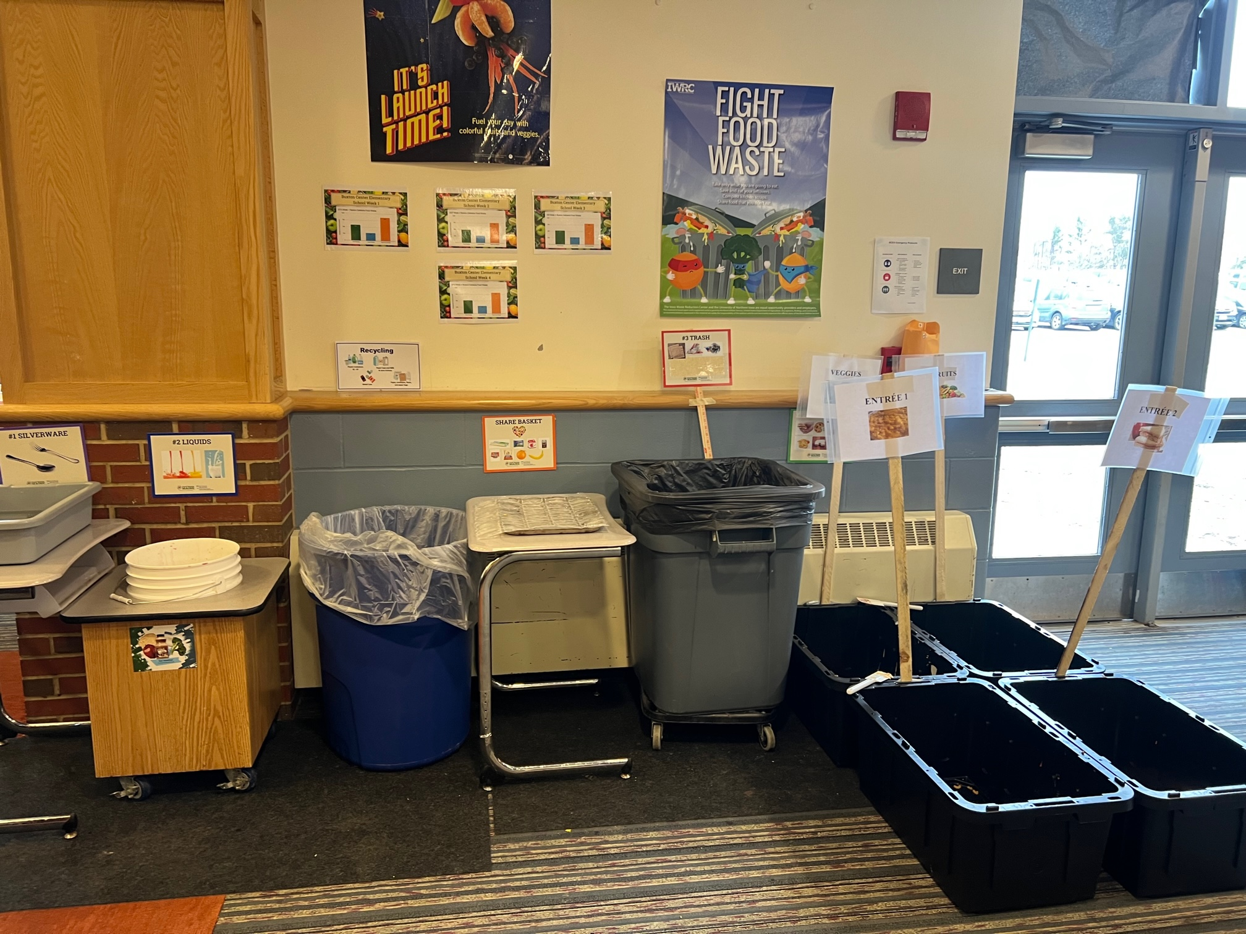
Maine Elementary School Cafeteria Food Waste Study
4) Food Waste Audit
umaine.edu/mitchellcenter l 207.581.3195 l umgmc@maine.edu
Notes:
We also conducted a food waste audit at the beginning and the end of our study at each elementary school. We served exactly the same meal for both of the audits to eliminate the impact of the food served on the waste levels. At the sorting station, instead of one food scraps bin, we separated the food waste by fruit, vegetable, and entree type in order to see food waste by type. This gave us the data needed to assess changes in fruit and veggie food waste based on our interventions.

Slide 9
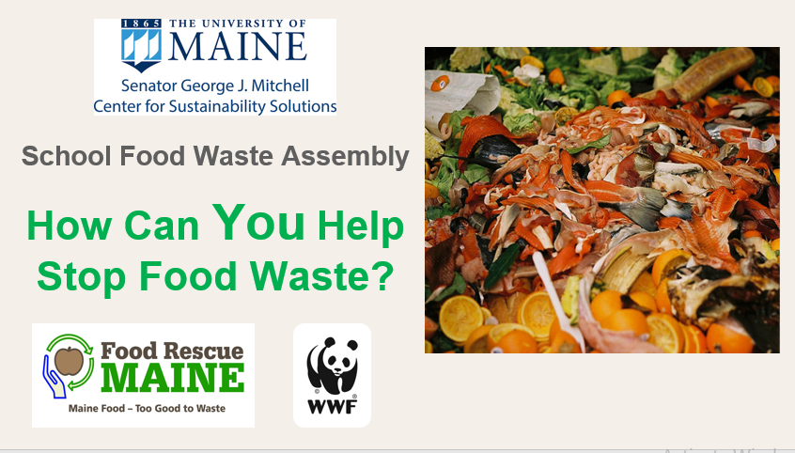
Maine Elementary School Cafeteria Food Waste Study
5) K-5 Food Waste Assembly Presentation
umaine.edu/mitchellcenter l 207.581.3195 l umgmc@maine.edu
Notes:
We conducted a quick but highly effective student/faculty assembly at each elementary school where we educated students on the “why” and “how” of reducing food waste. This presentation educates about how stopping food waste helps people and animals, fights climate change, and saves valuable resources by reducing food waste. It also educates about “What is a Meal?” to address a major cause of student waste - the confusion regarding what types and how much food must be taken at lunch. Students enjoyed a “meal/not a meal” quiz using actual food and milk samples from the cafeteria placed on a lunch tray showing different right and wrong “meal” selections! We concluded with the two things students can do to end food waste. The presentation is available upon request and a video version is being developed.

Slide 10

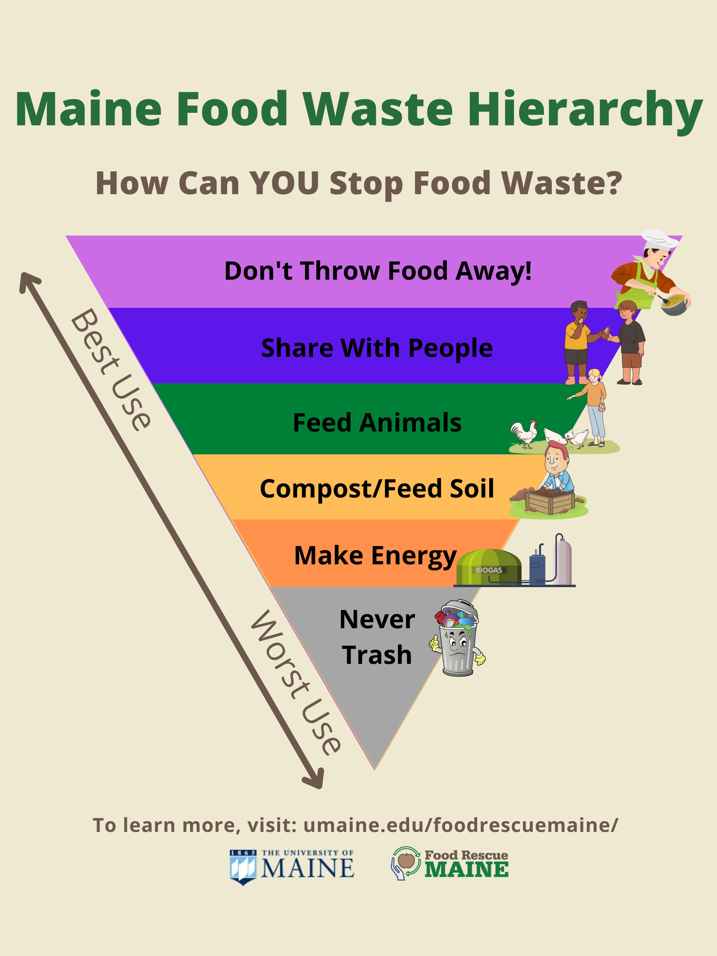


Maine Elementary School Cafeteria Food Waste Study
6) School Food Waste Posters
umaine.edu/mitchellcenter l 207.581.3195 l umgmc@maine.edu
Notes:
We selected educational posters to place around the schools to reinforce the messaging that food is something we use to fuel our bodies and does not belong in the trash. The two posters on the left were designed by our UMaine/Mitchell Center student interns.

Slide 11
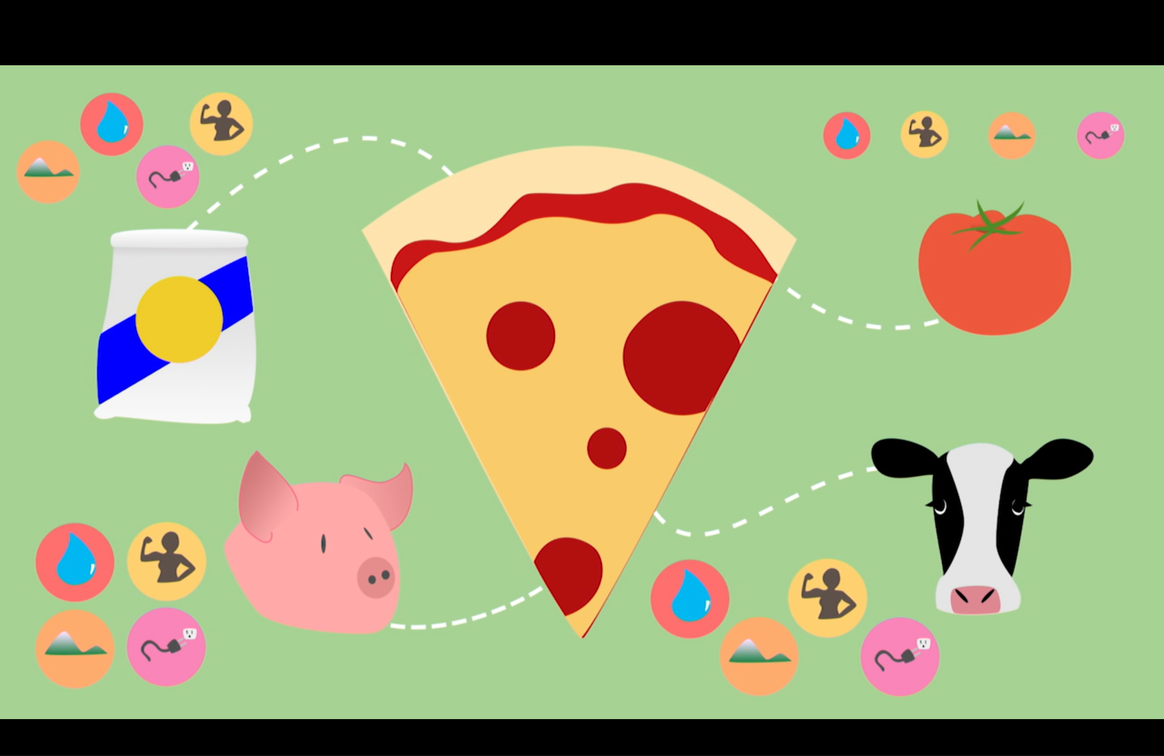
Maine Elementary School Cafeteria Food Waste Study
7) K-5 Food Waste Videos and Curriculum
umaine.edu/mitchellcenter l 207.581.3195 l umgmc@maine.edu
Notes:
We used a series of educational videos that the children were shown during their homeroom periods to continue to reinforce key ideas about food waste reduction.
https://mainepublic.pbslearningmedia.org/resource/ee18-sci-foodwst/kids-go-green-reducing-food-waste/?student=true&focus=true
Students were shown 3 videos with additional videos available for further education. Complete list of school food waste resources available upon request.

Slide 12
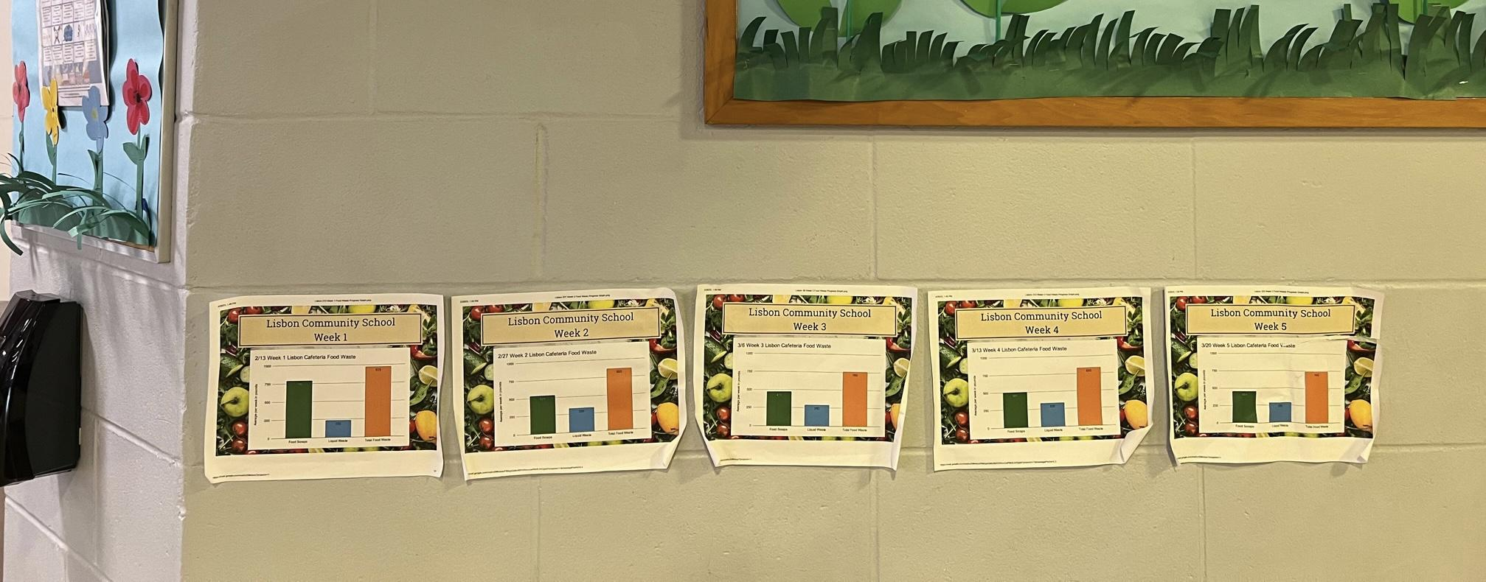
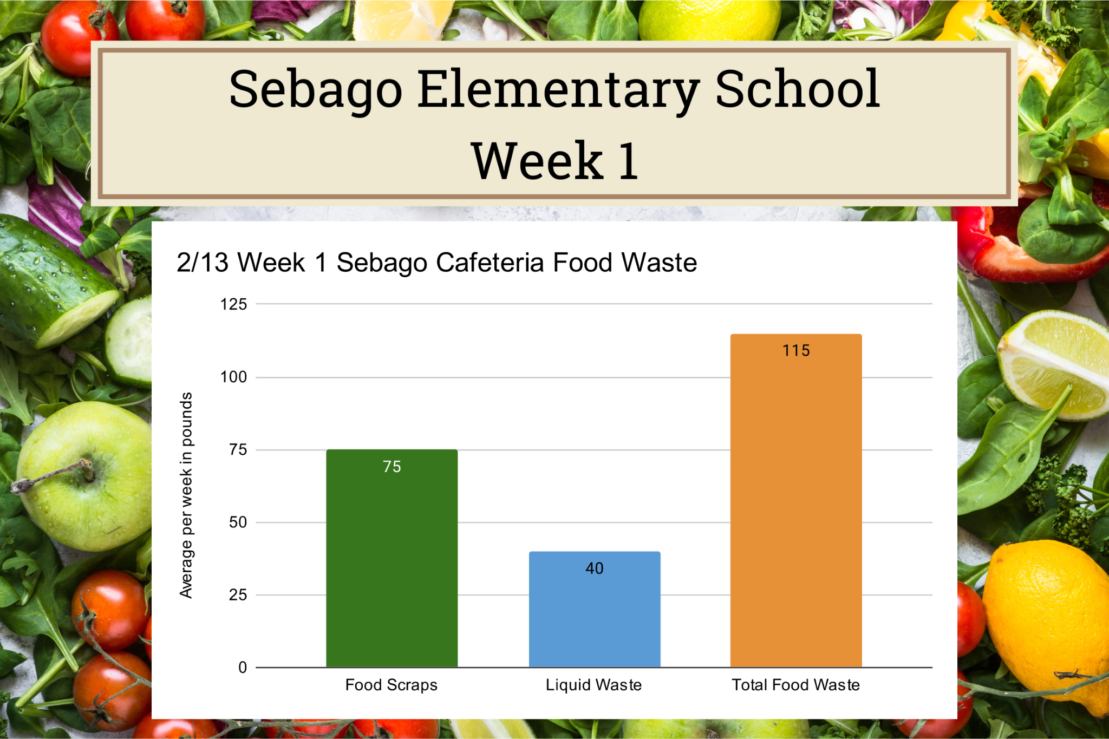
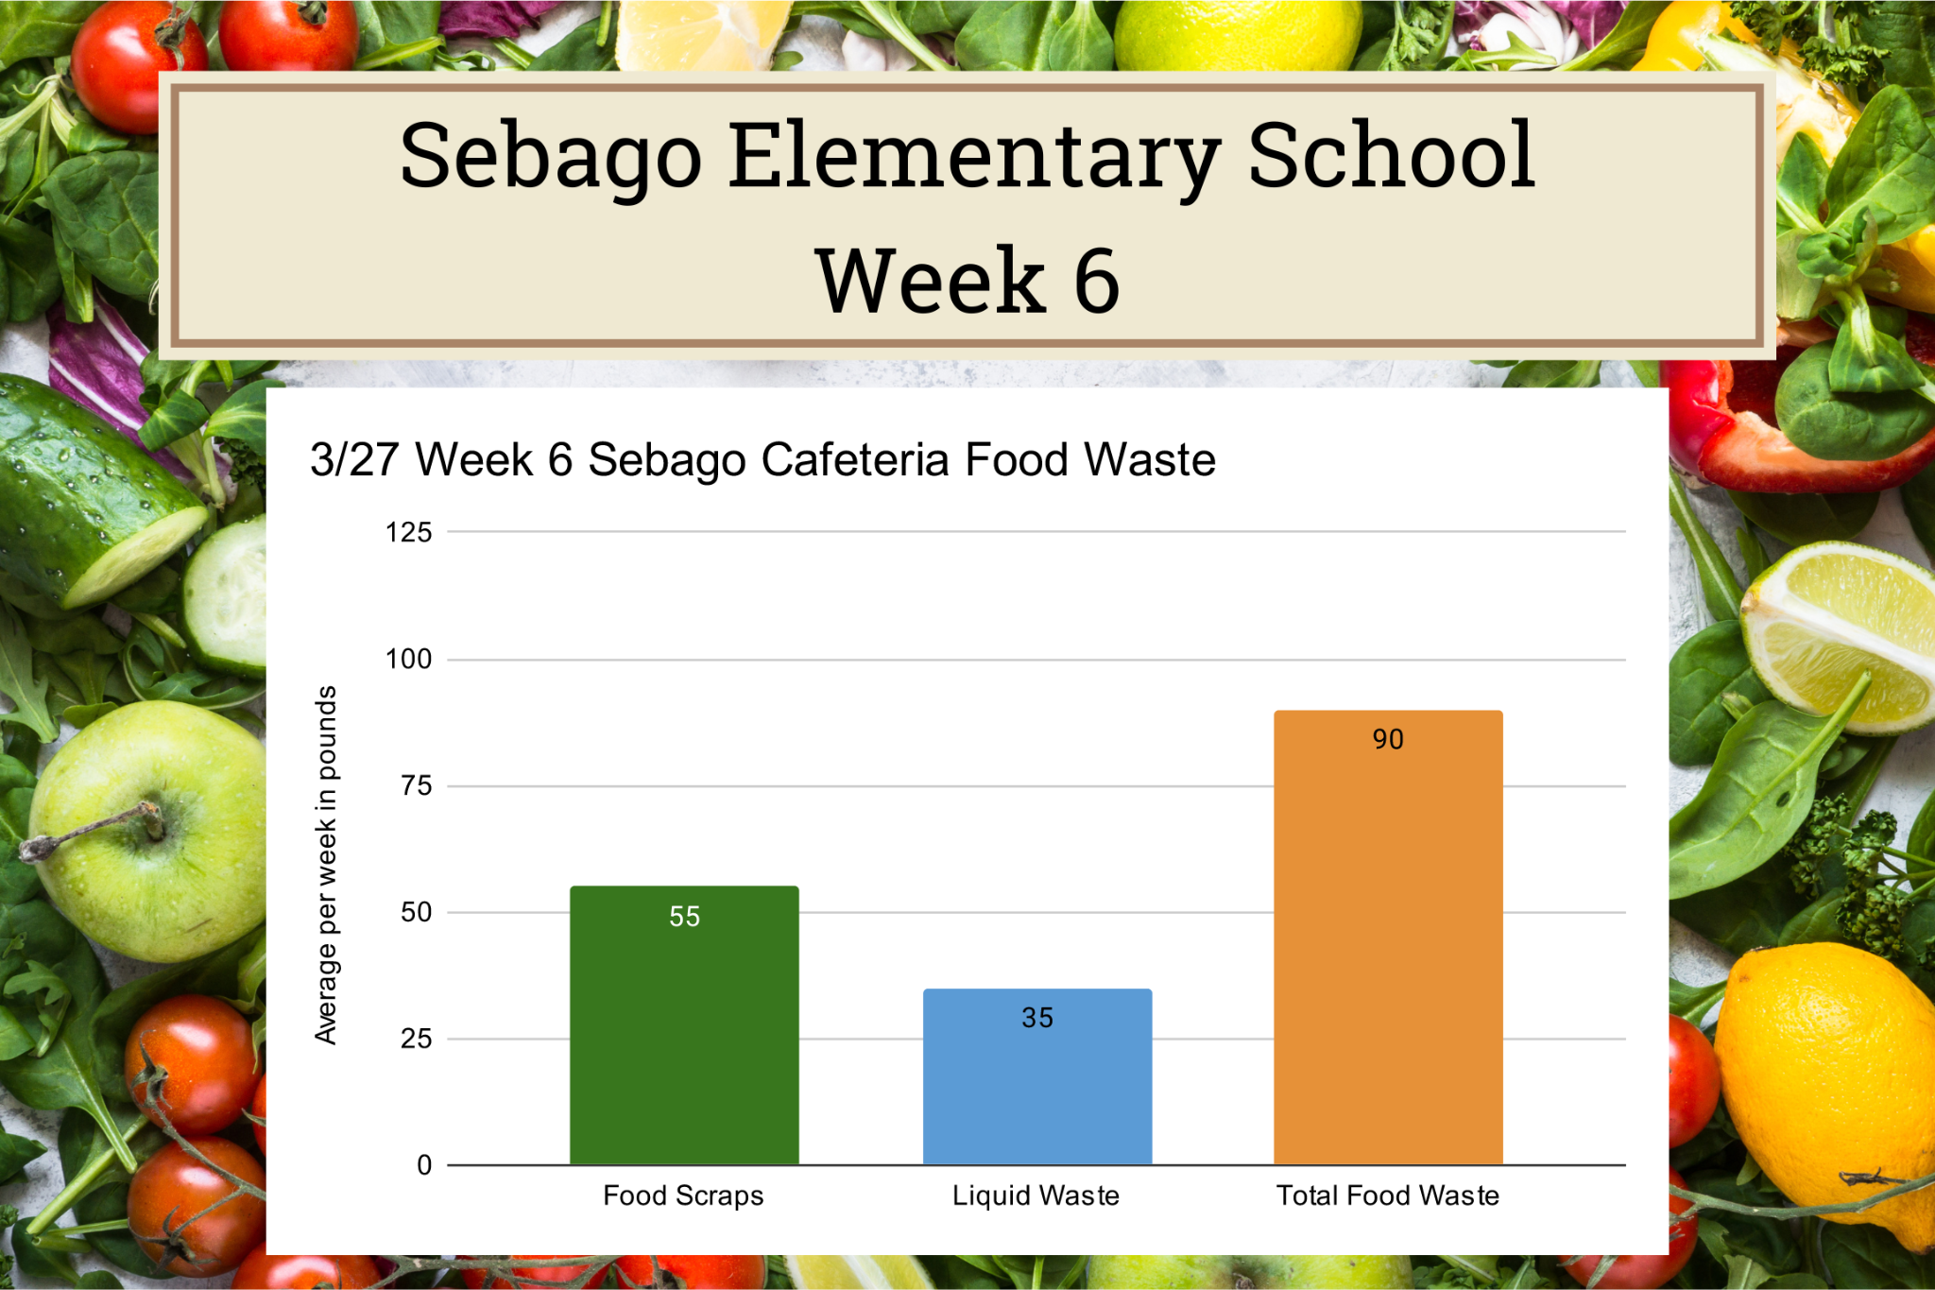
Maine Elementary School Cafeteria Food Waste Study
8) School Food Waste Progress Charts
umaine.edu/mitchellcenter l 207.581.3195 l umgmc@maine.edu
Notes:
As we collected data about the amount of food waste that the cafeterias were producing we also made progress charts that showed the children how much waste they were producing. They understood that they wanted to see a downward trend in the amount of food waste produced and this intervention acted as a progress scale for them to see how effectively they were reaching their goal.

Slide 13
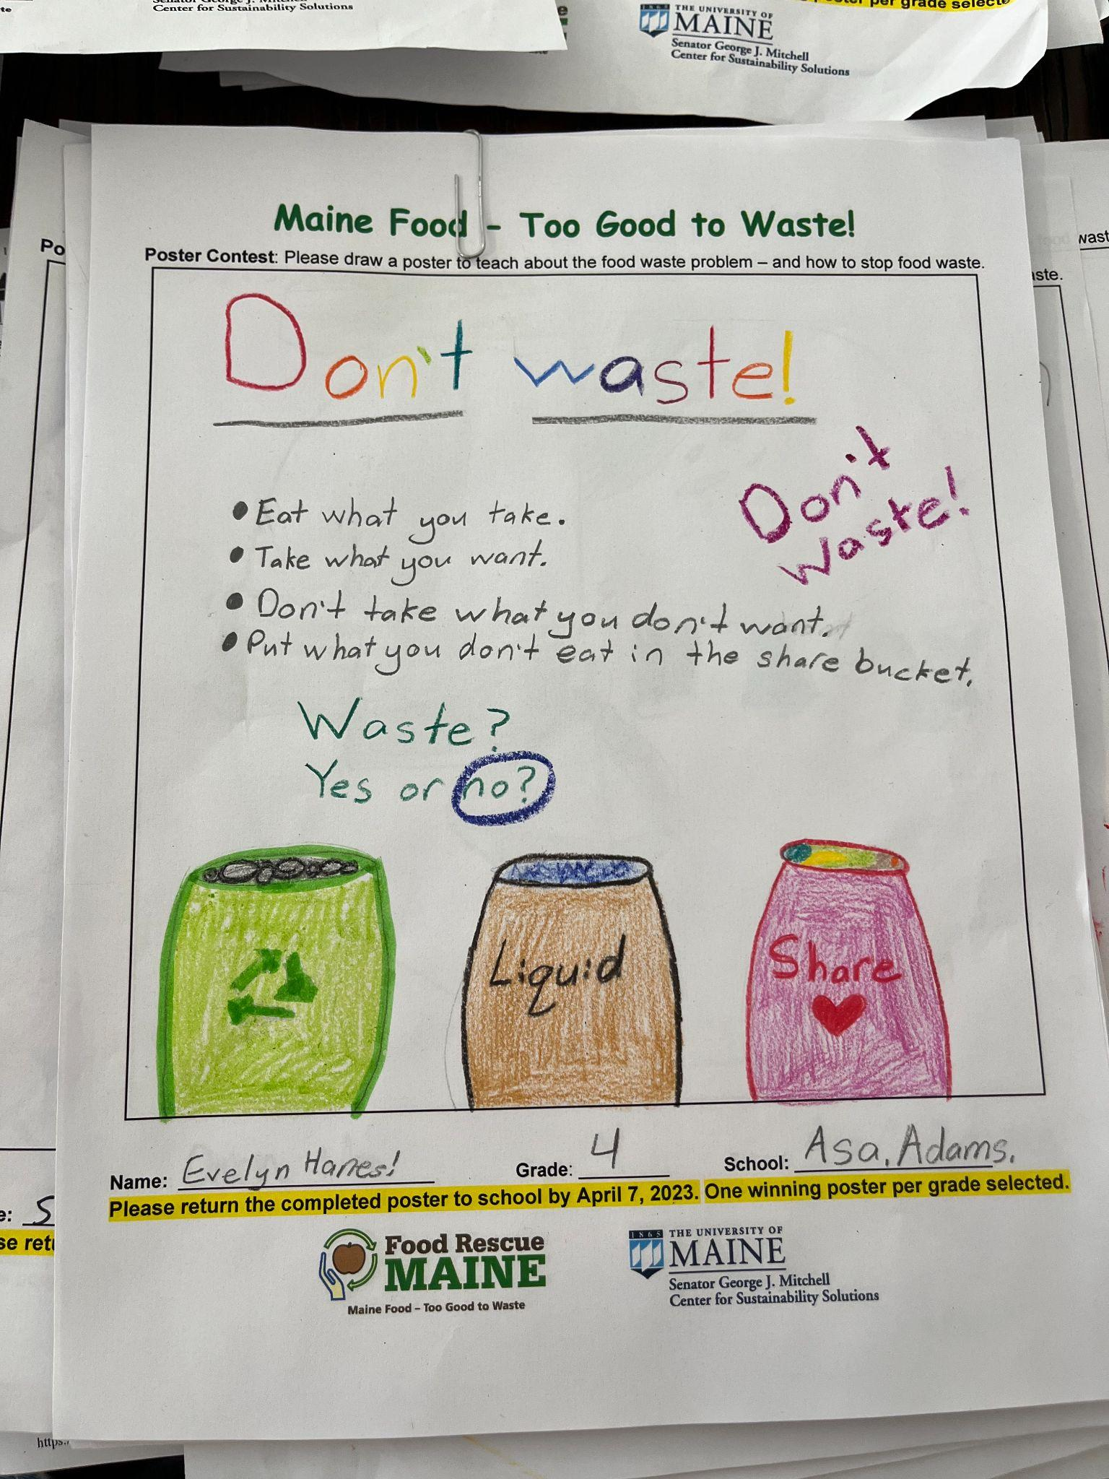
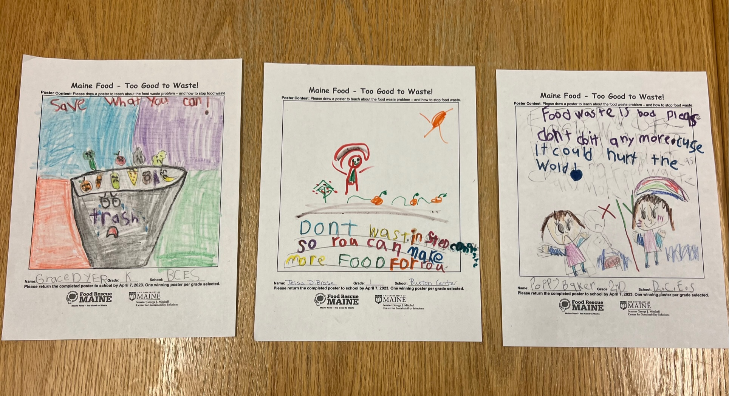
Maine Elementary School Cafeteria Food Waste Study
9) Poster Competition
umaine.edu/mitchellcenter l 207.581.3195 l umgmc@maine.edu
Notes:
We had a poster competition at the end of the study to allow the children to express and generate their own thoughts on what a good food waste reduction message would be. As you can see from the posters above, lots of the kids really loved it and made some amazing posters.

Slide 14
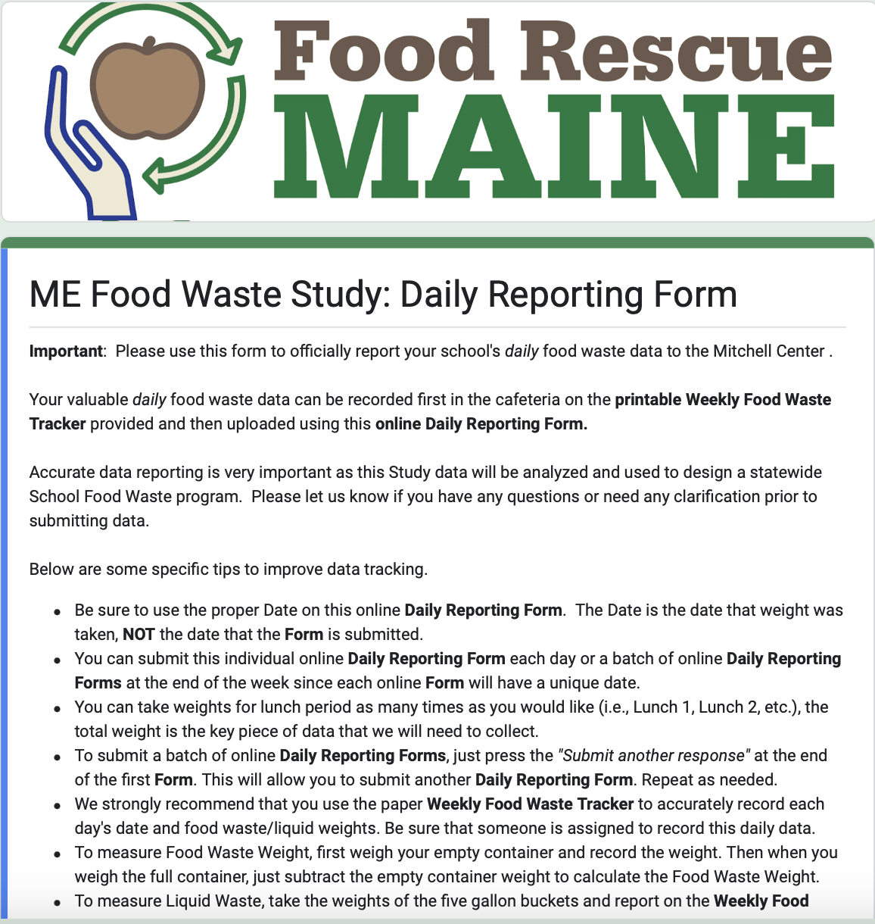
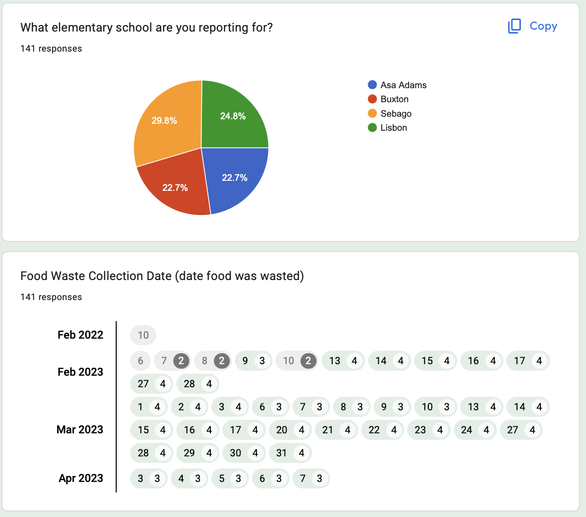
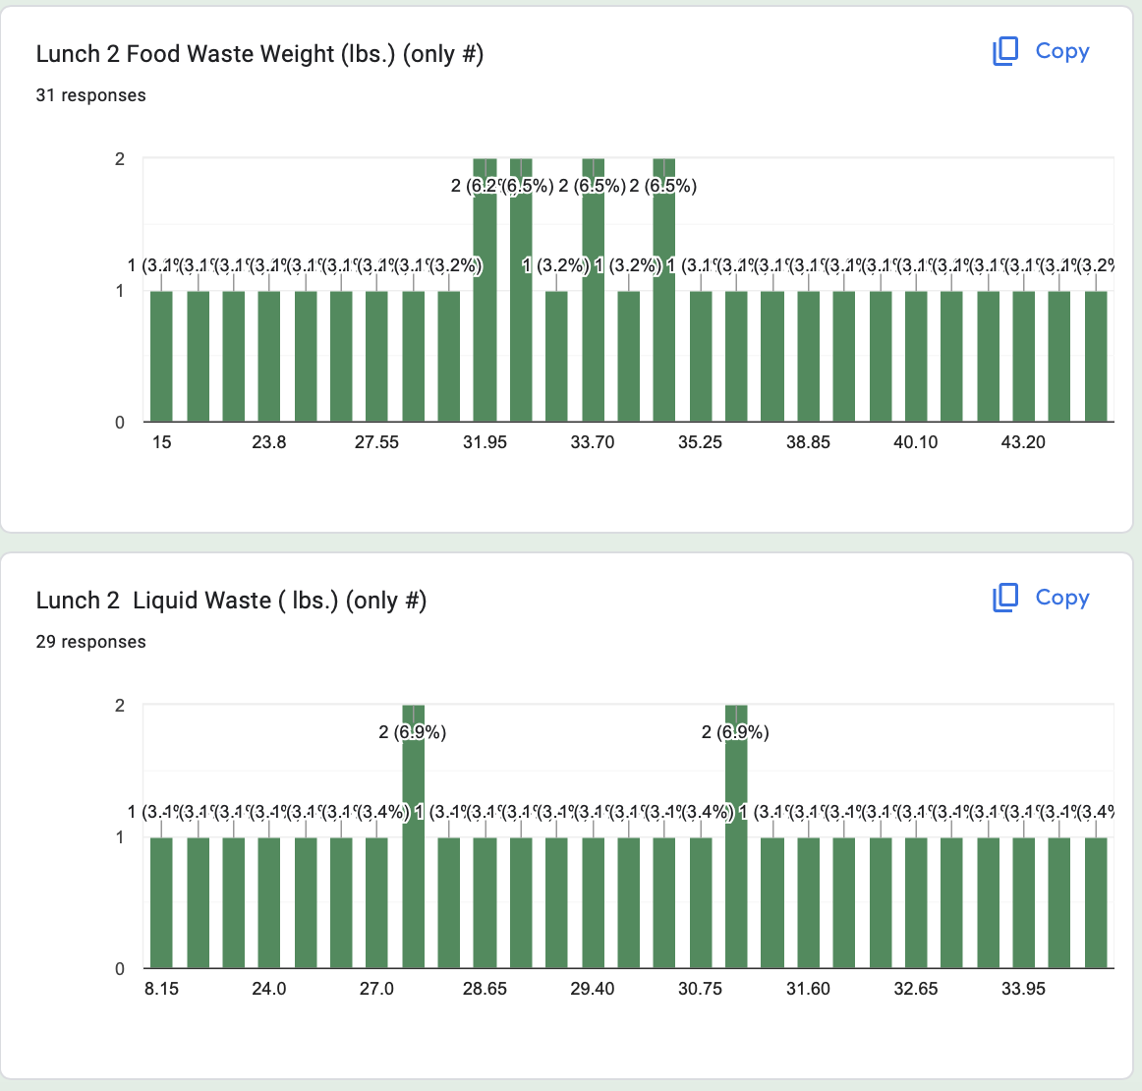
Maine Elementary School Cafeteria Food Waste Study
School Food Waste Data Tracking & Analysis
umaine.edu/mitchellcenter l 207.581.3195 l umgmc@maine.edu
Notes:
We used a number of data tracking practices for our food waste study: 1) school profile questionnaire, 2) simple family food waste online survey, 3) daily food & liquid food waste measurement, 4) optional kitchen food waste tracking, 5) food waste audit data measurement, 6) interviews with school cafeteria stakeholders

Slide 15
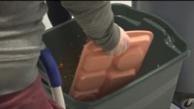
Maine Elementary School Cafeteria Food Waste Study
Study Promotion: Media
“UMaine researchers study food waste in school cafeterias…”
NewsCenter Maine, May 2023
umaine.edu/mitchellcenter l 207.581.3195 l umgmc@maine.edu
Notes:
Our Maine School Cafeteria Food Waste Study received positive media coverage in Spring 2023.

Slide 16
Maine Elementary School Cafeteria Food Waste Study
Next:
Study Results
umaine.edu/mitchellcenter l 207.581.3195 l umgmc@maine.edu
Notes:
Both quantitative and qualitative school food waste study data were collected and analyzed with positive results across all objectives.

